Slide 1



Meaning in Medicine
Created by: Richard Shugerman, MD, Diane Rawlins, M.A., Mollie Grow , MPH, MD
Notes:
Videos 22.5 min (missing interview) 27 min activity/slides
Richard Shugerman is the vice chair for faculty development in the department of pediatrics in the University of Washington School of Medicine and a faculty member in the division of pediatric emergency medicine at Seattle Children’s Hospital
Diane Rawlins is the principal at Inside Out Consulting.
Mollie Grow is a general pediatrician and associate program director of the University of Washington Pediatrics Residency program
Option to share:
Your (division chief/manager/etc) invited us here to talk about meaning in medicine because they care about your well-being. We are excited to present this session to you which was developed through a HRSA grant.
Change Notes-
Updates from previous: QR code attendance & QR code post survey

Slide 2
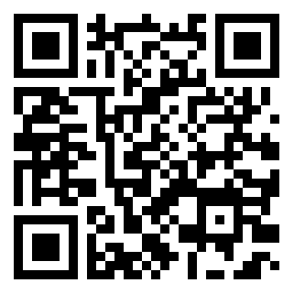
Please complete for attendance
Notes:
Videos 22.5 min (missing interview) 27 min activity/slides
Richard Shugerman is the vice chair for faculty development in the department of pediatrics in the University of Washington School of Medicine and a faculty member in the division of pediatric emergency medicine at Seattle Children’s Hospital
Diane Rawlins is the principal at Inside Out Consulting.
Mollie Grow is a general pediatrician and associate program director of the University of Washington Pediatrics Residency program
Option to share:
Your (division chief/manager/etc) invited us here to talk about meaning in medicine because they care about your well-being. We are excited to present this session to you which was developed through a HRSA grant.
Change Notes-
Updates from previous: QR code attendance & QR code post survey

Slide 3





Connecting with Joy & Meaning in Medicine
Promoting Your Well-Being
Building Resilience
Engaging with Peers to Improve Systems
Notes:
Our STREAM model incorporates four areas where we can work to improve our overall wellness: Well-Being, Resilience, Engagement and Joy and Meaning in Medicine

Slide 4
PERMAH
Accomplishment
Seligman, M. E. P. (2011). Flourish: A visionary new understanding of happiness and well-being. New York, NY: Free Press.
Notes:
That’s the PERMAH model of wellbeing from Seligman. Seligman’s model highlights the individual and systemic opportunities we have to increase our chances of FLOURISHING in challenging circumstances.
This particular session will be focusing on the joy of positive relationships and positive emotion.

Slide 5
Listen Respectfully
Practice Holding Complex Thought
Fully Participate
Rules of Engagement
Respect & Maintain Confidentiality
Speak From Own Experience
Be Open To New & Different Perspectives
Notes:
We hope that you all are able to be active participants today – that you’ll engage in both the reflective and the conversational elements of this session. And we also want to acknowledge that some of the tools that we’re using today take time, that reflection isn’t easy at a moments notice, but we hope that you’ll try to take this little leap with us…..

Slide 6

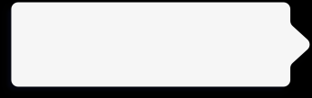


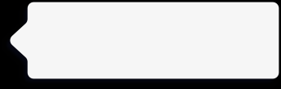
Roadmap:
Meaning in Medicine
How to focus on meaning
2
Why Focus on meaning
3
Using stories to connect to meaning
1

Slide 7
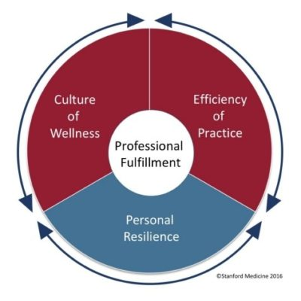
You practice in a flawed medical system
“Up to 80% of the causes of physician dissatisfaction and lack of well-being are systems issues” (Collier, R. CMAJ 2018)
Leading models of physician stress support the
concept that addressing systems issues will
have the greatest impact on physician wellness
Stanford Medicine
Model of Professional Fulfillment

Slide 8
Systems that Influence Individual Well-Being
Procedures, laws, regulations
Policy
Environmental structure, safety, access to health services
(Cultural values, norms)
Community
Work culture, efficiency of practice, values, goals
(formal and informal rules, operations)
Organizational
Friends, neighbors, co-workers, family
(social network)
Interpersonal
Physical, psychological, cognitive, spiritual
(knowledge, behaviors, skills)
Personal
Notes:
Individual well-being is complex interaction between personal level experiences, behaviors, and thoughts. Within the socioecologic model, each level adds it’s own layer of complexity.
Situating individual well-being

Slide 9
It’s easy to feel overwhelmed by the dysfunctional system
Notes:
Option 1: It’s easy to be overwhelmed by the dysfunctional system. However, you are part of the system. You can impact the system at multiple points of contact and those points can influence other points. Eventually, the system can work differently, which is the goal. All of the systems factors are important. Being in the practice of medicine is our calling and part of that is walking into other’s suffering everyday. We still need individual well-being strategies to while we also address the system factors so that we can still show up while we are working on changing the system. In STREAM, we want to challenge you to consider how you can apply (well-being, resilience, engagement, joy, meaning) strategies both to yourself and your work system.
Option 2: Raise you hand if you want the system to change, raise your hand if you want to be miserable while you wait. If we focus on individuals, we change how we show up to out work. This can make a very large impact and you have a choice!

Slide 10
Meaning and Inclusion
We actively seek to promote inclusion through our connections.
We welcome all to fully participate and benefit from cultivating a sense of well-being in our professional work
This concept should not be exclusive to those afforded particular privileges
Including all identities in experiencing joy and meaning through our stories and reflections allows us to grow, and to celebrate and deepen our connections to our patients, colleagues and our profession
Notes:
Video transcript for this slide (Richard Shugerman):
And when we talk about full and active participation, we want to specifically call out that we hope to promote a sense of inclusion for everyone who comes to these sessions. Much of the work that we do together will be through the sharing of our stories and sharing our thoughts and reflections on each other's stories. We know that all of us will benefit and all of us will be enriched if we can create the kind of space where everyone feels safe to share the stories that matter most to them.

Slide 11
PARTNER ACTIVITY: Everyday Meaning
Share with a partner where you find meaning in your life and work
3 minutes
Notes:
3 min

Slide 12


1. Why focus on meaning?

Slide 13
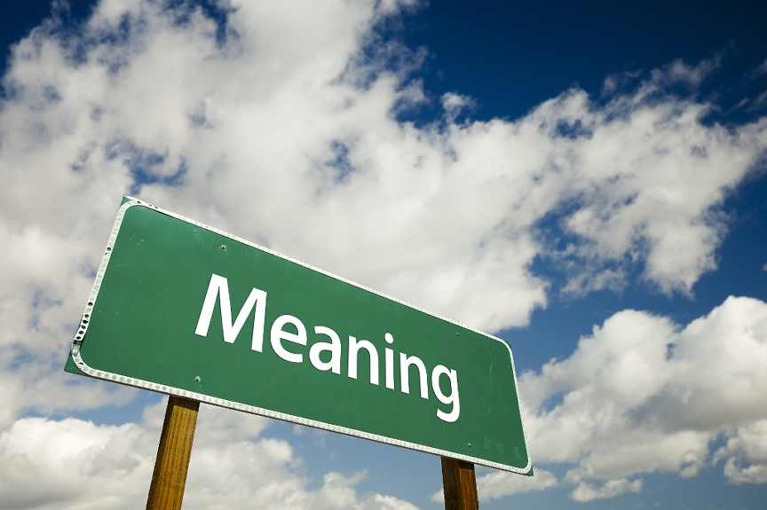
Why focus on meaning?
"Meaning enables people to make decisions based on options, values, plans and goals. Without meaning, behavior is guided by impulse and instinct.”
Roy Baumeister, social psychologist
For physicians, participation in meaningful activities correlates with reduced risk of burnout.
Tait Shanafelt MD
Notes:
You all might be wondering “How it is that a topic like finding meaning is in all of these models of well being….why do so many people place such great importance on it?
Well, people’s search for meaning is not a recent phenomenon and is certainly not exclusive to those of us in health care. Roy Baumeister is a contemporary social psychologist who has taught throughout the US and Australia, president of International Positive Psychology Association. I appreciate his perspective on why meaning is so important to humans, as quoted here - “Without meaning, behavior is guided by impulse and instinct.” Meaning is kind of what makes us human.
Within medicine, Tait Shanafelt is one of the leading scientists studying well being of health care providers. His research demonstrated that physicians at the Mayo Clinic who were able to devote at least 20% of their work week to activities that they found personally meaningful had significantly lower rates of burnout than their peers.
In short, having meaning is an orientation beyond oneself, a reason for living, that provides guidance in the way we respond and make decisions - and it appears to be protective against burnout.

Slide 14
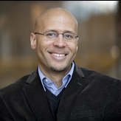
Benefits of knowing our purpose
Having a sense of purpose is a strong predictor of health and well-being
  Greater longevity
  Lower rates of heart attack and stroke
  Slower pace of cognitive decline
Having a sense of purpose helps us hold steady through times of stress and challenge
  Burrow, Anthony L., and Patrick L. Hill, eds. The Ecology of Purposeful Living Across the Lifespan. Cham, Switzerland: Springer Nature, 2020.
  https://hiddenbrain.org/podcast/cultivating-your-purpose/
Notes:
Video transcript for this slide (Richard Shugerman):
And just to go a little bit deeper into the importance of understanding where we find meaning and what is our purpose, we also wanted to acknowledge the work of Dr. Anthony Burrow in this area. We all learned about Dr. Burrow's work originally from a Hidden Brain podcast that each of us heard on NPR earlier this year, and that podcast is referenced at the bottom of this slide. It's definitely worth checking out if you have 60 minutes. But Dr. Burrow is a psychologist at Cornell University, and his research is focused on how having a sense of self-direction or having a sense of purpose in life serves as both a physiologic and a psychological resource for people who cultivate it.
So Dr. Burrow has done some really interesting research that demonstrates a correlation between how having a sense of purpose is directly related to having better indicators of health and well-being. Those indicators include higher longevity, lower incidence of heart attack or stroke, even slower rates of cognitive decline. at least suggestive evidence supporting that purpose is associated with a host of physiologic benefits. To me, one of the things that I find most exciting is his research on the psychological benefits of having a sense of purpose. And I think that's really directly referable to our work in health care. I know personally from working in the emergency department, I find this extremely interesting concept, but he's done some work that demonstrates how having a sense of purpose can help us maintain a sense of calm during moments of high stress or high challenge.
And Shankar Vedantan, who hosts the podcast that we all heard about Dr. Burrow's work from first, kind of captured it this way. He said, it's almost as if having purpose allows you to keep your eyes on the horizon so that the day-to-day challenges tend to knock you off course a little less because in some ways your eyes are always focused on the future.

Slide 15
2. How to focus on meaning?

Slide 16
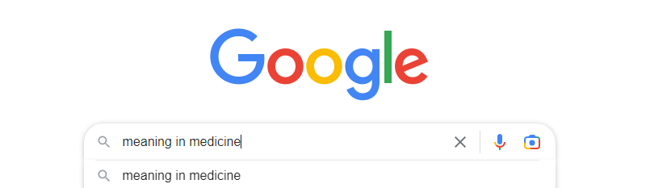
How to focus on meaning and purpose
Google “meaning in medicine”
  The Healer’s Art – Rachel Naomi Remen
  Finding Meaning in Medicine – Baylor College of Medicine
  Pediatric Residents' Perspectives on Humanism – Stanford University
  “Thriving in Scrubs” – Podcast
Virtually all re-connect physicians with meaning through stories
  That’s where the gold is.
Notes:
Video transcript for this slide (Diane Rawlins):
For the rest of this session, we're going to make a turn from why to how. When our sources of meaning have perhaps become vague or feel out of reach in our daily lives, how do we go about reclaiming and bringing back to life what we find meaningful in our work and our lives?
If you go to Google and ask Siri this question, which we did, you actually get a multitude of hits. But Google does not have the wisdom to look you in the eye and ask you about your sources of meaning, even if you type in, what do I find meaningful? Which brings us back to how? Well, it turns out that these references that you see here do give us a big clue about how we go about finding our meaning. Consistent across all of these sources is the idea that the gold is in our stories and looking within to examine our experiences, the decisions we've made, and the assumptions, explicit or implicit, that drove those decisions. So it is our lived experience that illustrate, animate, and even embody that which is meaningful to us. Recalling our own stories helps us gather our wits, see bigger patterns, and connect the dots of our lives. They are the doorway into what is meaningful to us. Walking through that doorway invites a certain discipline a slowing down so that you can notice what moves you, what motivates you. So it requires some practice, especially in a world of such high volume and high intensity. And in itself, the slowing down itself is a kind of centering practice. So in a few minutes, we're going to invite you all into that practice to recall one of your own stories, in this case, about a meaningful turning point in your lives.
First, Molly and Manish have kindly volunteered to tell us one or two of theirs.

Slide 17

Humans are storytellers
“For millennia humans have told stories to make sense of the world, articulate shared understanding, and build community.”
(Olson et al, Med Ed Online, 2021)
Stories are how we remember
Stories help us bring meaning and interpret our experiences
Stories have the potential to heal
Notes:
RICHARD
As Olson et al articulate, “We use stories in our everyday work as we describe the salient features of a disease process, build rapport with our patients, and teach trainees about the culture of our field. Through stories, we share our experiences, find meaning in the midst of grief and loss, and buoy each other through challenging times. “
https://www.tandfonline.com/doi/full/10.1080/10872981.2021.1929798#

Slide 18
3. Stories of Meaning

Slide 19
Facilitators: Edit this slide before presenting
Take 3 min or so to share a story of your own
Feel free to include a personal photo – a pic of you at the stage of your life the story takes place… or a even a stock photo of the institution, for example, where it ocurred
Include what helped your understand the importance if the experience you shared and how it fits in the scope of your work today
(if co presenting – could include an interchange/interview
w each other)
Notes:
Facilitators: Edit this slide before presenting
Maneesh’s story for reference:
My story is another one of a door opening. I had always been interested in international health, global health, of experiencing life in other cultures when I came to medicine. And my story of a door opening takes me back to my first year of residency in pediatrics, when I was enjoying just about every rotation and really had no clue about what I wanted to do for myself. future. And I was fortunate to have a away rotation in central Uganda during the end of my first year, where I had gone specifically to explore whether I could work in childhood malnutrition. It felt like a really important problem that I wanted to dedicate some time to after residency. And while I was there, I was moved by everything I was learning and experiencing and the opportunity to partner with providers and families there. And I found myself drawn to a side area of the pediatric ward where there were babies being cared for. And I was spending some time doing malnutrition rounds, but myself was drawn to what's happening over with
the babies and the parents. And there was an element of universality of welcoming a new member of a family into a family that experienced by the parents. And also, I remember experiencing something that I still appreciate today, and that's the gaze of a newborn right after they're born in that initial awake period. And, and holding the newborn with their family there or being held by their family and seeing that initial gaze, which, um, you know is is a is something that we all start as, as we all start as a newborn. And it was in that moment, the end of my first year of residency in central Uganda, that i decided i wanted to be a newbornologist and, and work on, um, work with families and and
caring for their newborns. And so it was that door opening that led to me pursuing a fellowship later in neonatology. And to this day, I continue to work in that hospital in Uganda and in other parts of Sub-Saharan Africa in partnering with providers and families to improve the lives of newborns.
Mollie’s story for reference:
When I started medical school, I was pretty sure I was going to go into geriatrics. I had had really close relationships with my grandparents and had really loved getting to know the elder members of the community and felt that it would be really neat to take care of them as a doctor and hear their stories and connect in an ongoing way with older people in the community. So I applied for a rotation in geriatrics after my first year of medical school. and was really excited to be selected. It was in Edinburgh, Scotland. It was an amazing opportunity. And it turns out that while I loved Edinburgh, I was not so in love with geriatrics. And I came back to medical school that fall and felt a little bit disillusioned and kind of wondering what my purpose was going to be if that wasn't it. And I was actually pretty sure it wasn't going to be pediatrics.
So I started my pediatrics rotation later in the year, and I was kind of struck almost immediately by one of the first patients that I got to see who was in the hospital for an asthma exacerbation. And he was about five or six, and he actually was by himself when we were seeing him. I'm not sure that would be allowed now, but he was. was telling us his kind of story about what had brought him in. And he had his arms behind his head. He was kind of kicking back in the bed and his voice was hoarse. And he was really adorable as he was trying to explain that, you know, his mom was convinced that it was the mices in their apartment that were causing his asthma and that they really had too many mices and they needed to do something about it. And he's just going on about this and I'm, you know, smiling to myself and
thinking this patient is just so compelling. I am just really loving getting to be part of his care, trying to help him get better from his asthma and also really compelled by thinking about the problems faced by his family who are in a situation with a rodent infestation that's led to his health being compromised and landing him in the hospital and thinking about his hardworking mom who wasn't able to be there and the circumstances and situations that were affecting kind of their social determinants of health. and. This window of possibility started to open for me to see how I could really commit myself to thinking about how do we address. Those needs for children and to be taking care of the whole family and the circumstances of their lives that.
lead to challenges and disparities in health. And that is part of the story of how I came to do what I do now and focused on addressing disparities for children's health as a general pediatrician.

Slide 20
4. Reflective Practice as a Tool

Slide 21
What is reflective Practice
Reflective practice is a continuous learning process where individuals recall their own actions as a source of personal development and professional improvement
Reflective practice asserts that experience alone does not necessarily lead to learning, but that it is reflecting on what one has experienced that leads to learning and personal growth
Notes:
Video transcript for this slide (Diane Rawlins):
Molly and Manish, those were beautiful stories. Thank you for sharing them with us. As you all probably know, engaging in this kind of inquiry is called reflective practice. So reflective practice is a continuous learning process where individuals recall their own actions and intentionally use these as a source of growth, development, improvement, Reflective practice asserts that experience alone does not necessarily lead to learning. It is actually the reflection upon your actions that leads to learning and personal growth. I hate to say it, but it is entirely possible to live a life of steady doing and not learn a bit from our mistakes or mine our gifts and successes.

Slide 22
Why Reflective Practice?
To understand why and how we got here
To reconnect with our path and purpose
To strengthen our spirit
To make meaning through our stories
Notes:
Video transcript for this slide (Diane Rawlins):
So why is reflective practice important? Well, it's important because we want to understand why and how we got to where we are in this moment of time. It helps us when we reflect to reconnect with our path and our purpose. What has our trajectory been and what has motivated us to be here now? This kind of reflection strengthens our spirit and it truly helps us make meaning through and of our stories.
The simplest way I know how to talk about the value of reflective practice is to recall a mentor of mine and Dr. Sugarman's named Parker Palmer, who once said this, Socrates said that an unexamined life is not worth living. I would add that if you choose to do that, please do not take a job that has you working with other people.

Slide 23
PARTNER ACTIVITY: Reflect/Pair Share
As you look back on your life, try to recall key moments or events that helped you develop a deeper understanding of your purpose. These might be influential teachers or readings, opportunities that were offered or denied to you, doors that opened or closed, decisions you made or did not make, tough challenges or exciting realizations.
Take a few minutes to remember one of these moments.
  What happened? How did the story unfold?
  What did you learn about what has meaning for you?
5 minutes: Write a few notes alone, 10 minutes: Pair/Share (5 min ea)
Notes:
Video transcript for this slide (Diane Rawlins):
So at this point, we want to encourage you to experiment and ponder this question for yourself. Here it is again. As you look back on your life, try to recall key moments or events that helped you develop a deeper understanding of your purpose. These might be influential teachers or readings, opportunities that were offered or denied to you, doors that opened or closed, decisions you made or did not make, tough challenges or exciting realizations. So the invitation here is to reflect alone for five minutes about one of those stories. And then we will get you into a small group where you'll have 10 minutes to talk with a colleague. During that time, we encourage you to split the time evenly to allow each of you to have the floor for five minutes and enjoy doing nothing but soaking up your partner's story for the other five minutes.

Slide 24
Large group debrief
How did it feel to share and listen to each others’ stories.
What did you learn about what has meaning for you?
Any thoughts on ways you can stay connected to what is meaningful to you as you go about your day?
Notes:
30 seconds, comment on those
We have some time to do some sense making together, something we rarely do anymore in our sped up world.
If no one volunteers, be thinking about how you could contribute if there is silence or crickets.

Slide 25
5. How to Continue this Work

Slide 26

GROUP ACTIVITY: Facilitating Connection
How can you infuse connection with meaning into your workflow and program?
How can we collectively and proactively facilitate connection with meaning:
On our own
With our trainees
With our colleagues
5 min
Notes:
10 min activity

Slide 27
Opportunities for further practice
On your own:
  Try journaling
  Write about a meaningful moment at the end of each day or week
With colleagues:
  Schedule a walking meeting with a trusted colleague once a month to talk about these issues
  Start a quarterly journal club in your division to engage others who share this interest
Notes:
Video transcript for this slide (Richard Shugerman):
Thanks everyone for joining us in this exercise over the last hour. We hope you've found this work to be helpful or meaningful in some way. And if so, we'd like to suggest opportunities for further practice in this area. We hope you'll think about perhaps on your own, trying journaling as a way to reconnect with meaningful moments that occur for you at the end of each day, or if every day seems like too much to try and do. Maybe once a week, just taking the time to think a little bit about an important event that happened during the course of that time. Or think about perhaps reaching beyond yourself to reconnect with your colleagues. Think about scheduling a walking meeting with with a trusted colleague once a month just to talk about these kinds of issues or other issues of importance to you.
Perhaps it would be something that you can consider doing as a quarterly journal club in your division to engage others who share in this interest. Hopefully for each of us, this is an opportunity to change culture one conversation at a time.

Slide 28
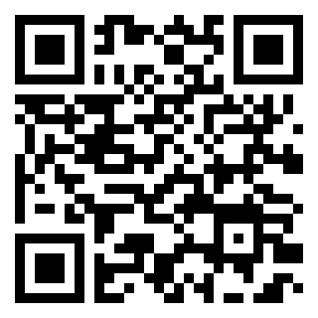
Thank you!
We want your feedback!
Help us by completing this short 3 question evaluation
We will also send a very short survey in 2 weeks
Additional resources are on the handout if you need more support

