Slide 1



Joy and Meaning
Created by : Richard Shugerman, MD, Diane Rawlins , M.A.,
Mollie Grow , MPH, MD , Maneesh Batra, MD
Notes:
Videos 39 min 39 min activities
Richard Shugerman is the vice chair for faculty development in the department of pediatrics in the University of Washington School of Medicine and a faculty member in the division of pediatric emergency medicine at Seattle Children’s Hospital
Diane Rawlins is the principal at Inside Out Consulting.
Mollie Grow is a general pediatrician and associate program director of the University of Washington Pediatrics Residency program
Maneesh Batra is the interim chief of neonatology at the University of Washington school of medicine department of pediatrics and a former program residency director at the University of Washington school of medicine
Option to share:
Your (division chief/manager/etc) invited us here to talk about joy and meaning (in medicine) because they care about your well-being. We are excited to present this session to you which was developed through a HRSA grant.
Change Notes-
Updates from previous: QR code attendance & QR code post survey, numbered sections, leadership note, twitter handle

Slide 2
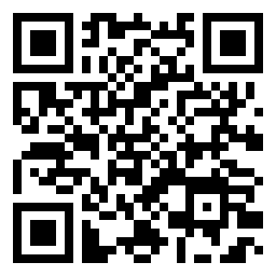
Please complete for attendance
Notes:
Videos 39 min 39 min activities
Richard Shugerman is the vice chair for faculty development in the department of pediatrics in the University of Washington School of Medicine and a faculty member in the division of pediatric emergency medicine at Seattle Children’s Hospital
Diane Rawlins is the principal at Inside Out Consulting.
Mollie Grow is a general pediatrician and associate program director of the University of Washington Pediatrics Residency program
Maneesh Batra is the interim chief of neonatology at the University of Washington school of medicine department of pediatrics and a former program residency director at the University of Washington school of medicine
Option to share:
Your (division chief/manager/etc) invited us here to talk about joy and meaning (in medicine) because they care about your well-being. We are excited to present this session to you which was developed through a HRSA grant.
Change Notes-
Updates from previous: QR code attendance & QR code post survey, numbered sections, leadership note, twitter handle

Slide 3





Connecting with Joy & Meaning in Medicine
Promoting Your Well-Being
Building Resilience
Engaging with Peers to Improve Systems
Notes:
Our STREAM model incorporates four areas where we can work to improve our overall wellness: Well-Being, Resilience, Engagement and Joy and Meaning in Medicine

Slide 4
PERMAH
Accomplishment
Seligman, M. E. P. (2011). Flourish: A visionary new understanding of happiness and well-being. New York, NY: Free Press.
Notes:
Maneesh
In the previous segment on Resilience…Jenny Reese shared another conceptual framework for these discussions.
That’s the PERMAH model of wellbeing from Seligman. As Jenny taught us, Seligman’s model highlights the individual and systemic opportunities we have to increase our chances of FLOURISHING in challenging circumstances. The previous session led by Diane and Richard focused on one of those important elements - connecting with meaning in our work.
This particular session will be focusing on the joy of positive relationships and positive emotion.

Slide 5
Listen Respectfully
Practice Holding Complex Thought
Fully Participate
Rules of Engagement
Respect & Maintain Confidentiality
Speak From Own Experience
Be Open To New & Different Perspectives
Notes:
@STREAM team…should we leave this slide as a prompt for facilitators? Or remove it? If we leave it, should we voice over or just show it?
Maneesh
As we did in the last session, we think it is important for sessions like these to re-visit the rules of engagement that Jan Serwint and Christine Yu Moutier shared at the beginning of our work together.
We hope that you all are able to be active participants today – that you’ll engage in both the reflective and the conversational elements of this session. And we also want to acknowledge that some of the tools that we’re using today take time, that reflection isn’t easy at a moments notice, but we hope that you’ll try to take this little leap with us…..

Slide 6

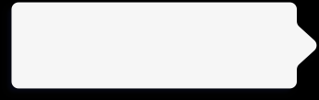


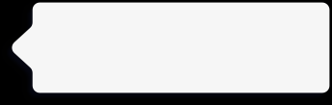
Roadmap:
Meaning in Medicine
Using stories to connect to meaning
2
Why Focus on meaning
3
Reflecting on joy in relationships
1

Slide 7
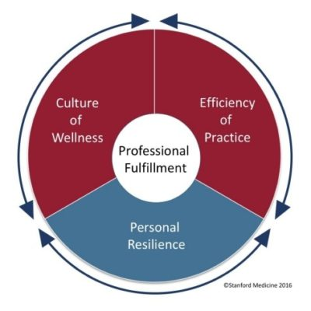
You practice in a flawed medical system
“Up to 80% of the causes of physician dissatisfaction and lack of well-being are systems issues” (Collier, R. CMAJ 2018)
Leading models of physician stress support the
Concept that addressing systems issues will
Have the greatest impact on physician wellness
Stanford Medicine Model of Wellness (2016)

Slide 8
Systems that Influence Individual Well-Being
Procedures, laws, regulations
Policy
Environmental structure, safety, access to health services
(Cultural values, norms)
Community
Work culture, efficiency of practice, values, goals
(formal and informal rules, operations)
Organizational
Friends, neighbors, co-workers, family
(social network)
Interpersonal
Physical, psychological, cognitive, spiritual
(knowledge, behaviors, skills)
Personal
Notes:
Individual well-being is complex interaction between personal level experiences, behaviors, and thoughts. Within the socioecologic model, each level adds it’s own layer of complexity.
Situating individual well-being

Slide 9
It’s easy to feel overwhelmed by the dysfunctional system
Notes:
Option 1: It’s easy to be overwhelmed by the dysfunctional system. However, you are part of the system. You can impact the system at multiple points of contact and those points can influence other points. Eventually, the system can work differently, which is the goal. All of the systems factors are important. Being in the practice of medicine is our calling and part of that is walking into other’s suffering everyday. We still need individual well-being strategies to while we also address the system factors so that we can still show up while we are working on changing the system. In STREAM, we want to challenge you to consider how you can apply (well-being, resilience, engagement, joy, meaning) strategies both to yourself and your work system.
Option 2: Raise you hand if you want the system to change, raise your hand if you want to be miserable while you wait. If we focus on individuals, we change how we show up to out work. This can make a very large impact and you have a choice!

Slide 10
Meaning and Inclusion
We actively seek to promote inclusion through our connections.
We welcome all to fully participate and benefit from cultivating a sense of well-being in our professional work
This concept should not be exclusive to those afforded particular privileges
Including all identities in experiencing joy and meaning through our stories and reflections allows us to grow, and to celebrate and deepen our connections to our patients, colleagues and our profession
Notes:
Video transcript for this slide (Richard Shugerman):
And when we talk about full and active participation, we want to specifically call out that we hope to promote a sense of inclusion for everyone who comes to these sessions. Much of the work that we do together will be through the sharing of our stories and sharing our thoughts and reflections on each other's stories. We know that all of us will benefit and all of us will be enriched if we can create the kind of space where everyone feels safe to share the stories that matter most to them.

Slide 11
PARTNER ACTIVITY: Everyday Meaning
Share with a partner where you find meaning in your life and work
3 minutes
Notes:
3 min

Slide 12


1. Why focus on meaning?

Slide 13
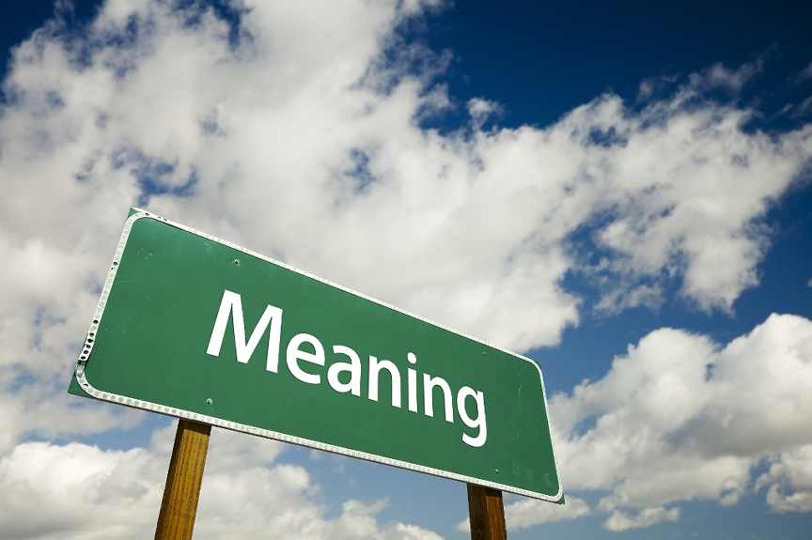
Why focus on meaning?
"Meaning enables people to make decisions based on options, values, plans and goals. Without meaning, behavior is guided by impulse and instinct.”
Roy Baumeister, social psychologist
For physicians, participation in meaningful activities correlates with reduced risk of burnout.
Tait Shanafelt MD
Notes:
You all might be wondering “How it is that a topic like finding meaning is in all of these models of well being….why do so many people place such great importance on it?
Well, people’s search for meaning is not a recent phenomenon and is certainly not exclusive to those of us in health care. Roy Baumeister is a contemporary social psychologist who has taught throughout the US and Australia, president of International Positive Psychology Association. I appreciate his perspective on why meaning is so important to humans, as quoted here - “Without meaning, behavior is guided by impulse and instinct.” Meaning is kind of what makes us human.
Within medicine, Tait Shanafelt is one of the leading scientists studying well being of health care providers. His research demonstrated that physicians at the Mayo Clinic who were able to devote at least 20% of their work week to activities that they found personally meaningful had significantly lower rates of burnout than their peers.
In short, having meaning is an orientation beyond oneself, a reason for living, that provides guidance in the way we respond and make decisions - and it appears to be protective against burnout.

Slide 14
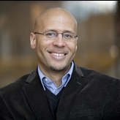
Benefits of knowing our purpose
Having a sense of purpose is a strong predictor of health and well-being
  Greater longevity
  Lower rates of heart attack and stroke
  Slower pace of cognitive decline
Having a sense of purpose helps us hold steady through times of stress and challenge
  Burrow, Anthony L., and Patrick L. Hill, eds. The Ecology of Purposeful Living Across the Lifespan. Cham, Switzerland: Springer Nature, 2020.
  https://hiddenbrain.org/podcast/cultivating-your-purpose/
Notes:
Video transcript for this slide (Richard Shugerman):
And just to go a little bit deeper into the importance of understanding where we find meaning and what is our purpose, we also wanted to acknowledge the work of Dr. Anthony Burrow in this area. We all learned about Dr. Burrow's work originally from a Hidden Brain podcast that each of us heard on NPR earlier this year, and that podcast is referenced at the bottom of this slide. It's definitely worth checking out if you have 60 minutes. But Dr. Burrow is a psychologist at Cornell University, and his research is focused on how having a sense of self-direction or having a sense of purpose in life serves as both a physiologic and a psychological resource for people who cultivate it.
So Dr. Burrow has done some really interesting research that demonstrates a correlation between how having a sense of purpose is directly related to having better indicators of health and well-being. Those indicators include higher longevity, lower incidence of heart attack or stroke, even slower rates of cognitive decline. at least suggestive evidence supporting that purpose is associated with a host of physiologic benefits. To me, one of the things that I find most exciting is his research on the psychological benefits of having a sense of purpose. And I think that's really directly referable to our work in health care. I know personally from working in the emergency department, I find this extremely interesting concept, but he's done some work that demonstrates how having a sense of purpose can help us maintain a sense of calm during moments of high stress or high challenge.
And Shankar Vedantan, who hosts the podcast that we all heard about Dr. Burrow's work from first, kind of captured it this way. He said, it's almost as if having purpose allows you to keep your eyes on the horizon so that the day-to-day challenges tend to knock you off course a little less because in some ways your eyes are always focused on the future.

Slide 15
2. How to focus on meaning?

Slide 16
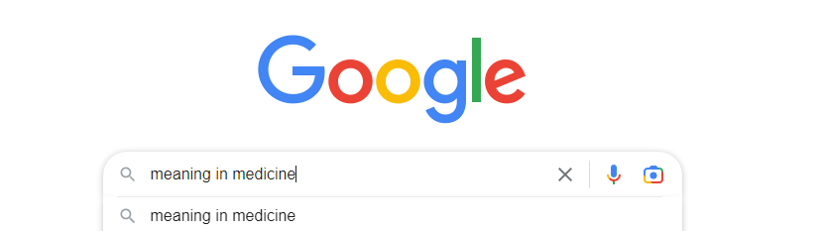
How to focus on meaning and purpose
Google “meaning in medicine”
  The Healer’s Art – Rachel Naomi Remen
  Finding Meaning in Medicine – Baylor College of Medicine
  Pediatric Residents' Perspectives on Humanism – Stanford University
  “Thriving in Scrubs” – Podcast
Virtually all re-connect physicians with meaning through stories
  That’s where the gold is.
Notes:
Video transcript for this slide (Diane Rawlins):
For the rest of this session, we're going to make a turn from why to how. When our sources of meaning have perhaps become vague or feel out of reach in our daily lives, how do we go about reclaiming and bringing back to life what we find meaningful in our work and our lives?
If you go to Google and ask Siri this question, which we did, you actually get a multitude of hits. But Google does not have the wisdom to look you in the eye and ask you about your sources of meaning, even if you type in, what do I find meaningful? Which brings us back to how? Well, it turns out that these references that you see here do give us a big clue about how we go about finding our meaning. Consistent across all of these sources is the idea that the gold is in our stories and looking within to examine our experiences, the decisions we've made, and the assumptions, explicit or implicit, that drove those decisions. So it is our lived experience that illustrate, animate, and even embody that which is meaningful to us. Recalling our own stories helps us gather our wits, see bigger patterns, and connect the dots of our lives. They are the doorway into what is meaningful to us. Walking through that doorway invites a certain discipline a slowing down so that you can notice what moves you, what motivates you. So it requires some practice, especially in a world of such high volume and high intensity. And in itself, the slowing down itself is a kind of centering practice. So in a few minutes, we're going to invite you all into that practice to recall one of your own stories, in this case, about a meaningful turning point in your lives.
First, Molly and Manish have kindly volunteered to tell us one or two of theirs.

Slide 17

Humans are storytellers
“For millennia humans have told stories to make sense of the world, articulate shared understanding, and build community.”
(Olson et al, Med Ed Online, 2021)
Stories are how we remember
Stories help us bring meaning and interpret our experiences
Stories have the potential to heal
Notes:
RICHARD
As Olson et al articulate, “We use stories in our everyday work as we describe the salient features of a disease process, build rapport with our patients, and teach trainees about the culture of our field. Through stories, we share our experiences, find meaning in the midst of grief and loss, and buoy each other through challenging times. “
https://www.tandfonline.com/doi/full/10.1080/10872981.2021.1929798#

Slide 18
3. Stories of Meaning:

Slide 19
Facilitators: Edit before presenting
Take 3 min or so to share a story of your own
Feel free to include a personal photo – a pic of you at the stage of your life the story takes place… or a even a stock photo of the institution, for example, where it ocurred
Include what helped your understand the importance if the experience you shared and how it fits in the scope of your work today
(if co presenting – could include an interchange/interview
w each other)
Notes:
Maneesh’s story for reference:
My story is another one of a door opening. I had always been interested in international health, global health, of experiencing life in other cultures when I came to medicine. And my story of a door opening takes me back to my first year of residency in pediatrics, when I was enjoying just about every rotation and really had no clue about what I wanted to do for myself. future. And I was fortunate to have a away rotation in central Uganda during the end of my first year, where I had gone specifically to explore whether I could work in childhood malnutrition. It felt like a really important problem that I wanted to dedicate some time to after residency. And while I was there, I was moved by everything I was learning and experiencing and the opportunity to partner with providers and families there. And I found myself drawn to a side area of the pediatric ward where there were babies being cared for. And I was spending some time doing malnutrition rounds, but myself was drawn to what's happening over with
the babies and the parents. And there was an element of universality of welcoming a new member of a family into a family that experienced by the parents. And also, I remember experiencing something that I still appreciate today, and that's the gaze of a newborn right after they're born in that initial awake period. And, and holding the newborn with their family there or being held by their family and seeing that initial gaze, which, um, you know is is a is something that we all start as, as we all start as a newborn. And it was in that moment, the end of my first year of residency in central Uganda, that i decided i wanted to be a newbornologist and, and work on, um, work with families and and
caring for their newborns. And so it was that door opening that led to me pursuing a fellowship later in neonatology. And to this day, I continue to work in that hospital in Uganda and in other parts of Sub-Saharan Africa in partnering with providers and families to improve the lives of newborns.
Mollie’s story for reference:
When I started medical school, I was pretty sure I was going to go into geriatrics. I had had really close relationships with my grandparents and had really loved getting to know the elder members of the community and felt that it would be really neat to take care of them as a doctor and hear their stories and connect in an ongoing way with older people in the community. So I applied for a rotation in geriatrics after my first year of medical school. and was really excited to be selected. It was in Edinburgh, Scotland. It was an amazing opportunity. And it turns out that while I loved Edinburgh, I was not so in love with geriatrics. And I came back to medical school that fall and felt a little bit disillusioned and kind of wondering what my purpose was going to be if that wasn't it. And I was actually pretty sure it wasn't going to be pediatrics.
So I started my pediatrics rotation later in the year, and I was kind of struck almost immediately by one of the first patients that I got to see who was in the hospital for an asthma exacerbation. And he was about five or six, and he actually was by himself when we were seeing him. I'm not sure that would be allowed now, but he was. was telling us his kind of story about what had brought him in. And he had his arms behind his head. He was kind of kicking back in the bed and his voice was hoarse. And he was really adorable as he was trying to explain that, you know, his mom was convinced that it was the mices in their apartment that were causing his asthma and that they really had too many mices and they needed to do something about it. And he's just going on about this and I'm, you know, smiling to myself and
thinking this patient is just so compelling. I am just really loving getting to be part of his care, trying to help him get better from his asthma and also really compelled by thinking about the problems faced by his family who are in a situation with a rodent infestation that's led to his health being compromised and landing him in the hospital and thinking about his hardworking mom who wasn't able to be there and the circumstances and situations that were affecting kind of their social determinants of health. and. This window of possibility started to open for me to see how I could really commit myself to thinking about how do we address. Those needs for children and to be taking care of the whole family and the circumstances of their lives that.
lead to challenges and disparities in health. And that is part of the story of how I came to do what I do now and focused on addressing disparities for children's health as a general pediatrician.

Slide 20
4. Reflective Practice as a Tool

Slide 21
What is Reflective Practice?
Reflective practice is a continuous learning process where individuals recall their own actions as a source of personal and professional development
Reflective practice asserts that experience alone does not necessarily lead to learning, but that it is reflecting on what one has experienced that leads to learning and growth.
Notes:
Video transcript for this slide (Diane Rawlins):
Molly and Manish, those were beautiful stories. Thank you for sharing them with us. As you all probably know, engaging in this kind of inquiry is called reflective practice. So reflective practice is a continuous learning process where individuals recall their own actions and intentionally use these as a source of growth, development, improvement, Reflective practice asserts that experience alone does not necessarily lead to learning. It is actually the reflection upon your actions that leads to learning and personal growth. I hate to say it, but it is entirely possible to live a life of steady doing and not learn a bit from our mistakes or mine our gifts and successes.

Slide 22
PARTNER ACTIVITY: Reflect/Pair Share
As you look back on your life, try to recall key moments or events that helped you develop a deeper understanding of your purpose. These might be influential teachers or readings, opportunities that were offered or denied to you, doors that opened or closed, decisions you made or did not make, tough challenges or exciting realizations.
Take a few minutes to remember one of these moments.
  What happened? How did the story unfold?
  What did you learn about what has meaning for you?
5 minutes: Write a few notes alone, 10 minutes: Pair/Share (5 min ea)
Notes:
Video transcript for this slide (Diane Rawlins):
So at this point, we want to encourage you to experiment and ponder this question for yourself. Here it is again. As you look back on your life, try to recall key moments or events that helped you develop a deeper understanding of your purpose. These might be influential teachers or readings, opportunities that were offered or denied to you, doors that opened or closed, decisions you made or did not make, tough challenges or exciting realizations. So the invitation here is to reflect alone for five minutes about one of those stories. And then we will get you into a small group where you'll have 10 minutes to talk with a colleague. During that time, we encourage you to split the time evenly to allow each of you to have the floor for five minutes and enjoy doing nothing but soaking up your partner's story for the other five minutes.

Slide 23
Large group debrief
How did it feel to share and listen to each others’ stories.
What did you learn about what has meaning for you?
Any thoughts on ways you can stay connected to what is meaningful to you as you go about your day?
Notes:
30 seconds, comment on those
We have some time to do some sense making together, something we rarely do anymore in our sped up world.
If no one volunteers, be thinking about how you could contribute if there is silence or crickets.

Slide 24
5. How to continue this work

Slide 25
Opportunities for further practice
On your own:
  Try journaling
  Write about a meaningful moment at the end of each day or week
With colleagues:
  Schedule a walking meeting with a trusted colleague once a month to talk about these issues
  Start a quarterly journal club in your division to engage others who share this interest
Notes:
Video transcript for this slide (Richard Shugerman):
we'd like to suggest opportunities for further practice in this area. We hope you'll think about perhaps on your own, trying journaling as a way to reconnect with meaningful moments that occur for you at the end of each day, or if every day seems like too much to try and do. Maybe once a week, just taking the time to think a little bit about an important event that happened during the course of that time. Or think about perhaps reaching beyond yourself to reconnect with your colleagues. Think about scheduling a walking meeting with with a trusted colleague once a month just to talk about these kinds of issues or other issues of importance to you.
Perhaps it would be something that you can consider doing as a quarterly journal club in your division to engage others who share in this interest. Hopefully for each of us, this is an opportunity to change culture one conversation at a time.

Slide 26


Joy
Notes:
divider

Slide 27
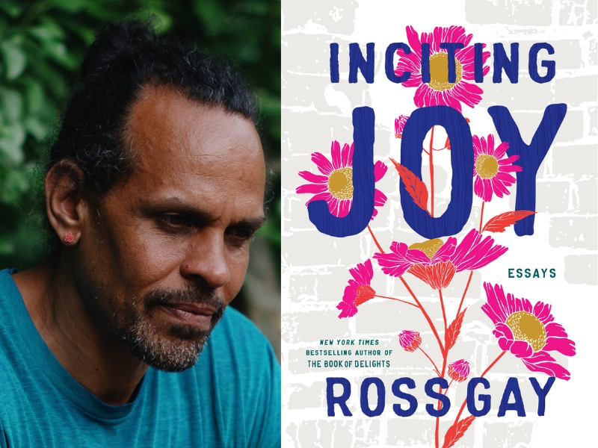
Invitation and welcome
“What if joy is not only entangled with pain, or suffering, or sorrow, but is also what emerges from how we care for each other through these things? What if joy, instead of refuge or relief from heartbreak, is what effloresces from us as we help each other carry our heartbreaks?”
-Ross Gay “Inciting Joy”
Notes:
we hope to have a space to reflect on how joy may show up differently for each of us. In some ways, the concept of joy may feel almost loaded and even unattainable in our current state of the world. The word joy might invoke simply a state of bliss or privilege or some beach vacation. However, we felt it would be helpful to offer an expanded view of what joy may mean. Poet Ross Gay, in his collection of essays inciting joy, shared this in his writing. What if joy is not only entangled with pain or suffering or sorrow, but is also what emerges from how we care for each other through these things? What if joy, instead of refuge or relief from heartbreak,
is what effloresces from us as we help each other carry our heartbreaks. It feels very important to reclaim joy, maybe not so much as a sense of ecstasy, but more aligned with calling forth our meaning and connection, particularly in the heartache experienced by many dealing with losses from COVID and racism. There are a multitude of ways in which joy can be shared through our connections, that we may hold the heartbreak in our professional work and a sense of joy at the same time as a both and phenomenon is possible.

Slide 28
PARTNER ACTIVITY:
Reflect on a moment of positive connection with someone recently
Think about who you shared that moment with and share what made it joyful.
3 minutes
Notes:
4 min
Mollie
SO to jump start focusing on joy moments, we offer a chance to call to mind a moment of positive connection with someone recently.
Think about who you shared that moment with and what made it joyful.
Post in the chat
Diane and Shug share an example

Slide 29
6. Positive impact of Joy

Slide 30
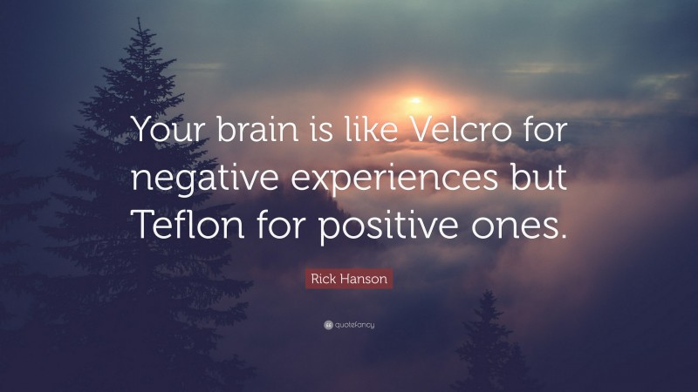
Notes:
Video transcript for this slide (Mollie Grow):
One of our team’s favorite quotes related to STREAM is this one from psychologist Rick Hanson, “Your brain is like Velcro for negative experiences but Teflon for positive ones.” This very apt phrase links to content from prior STREAM sessions on mental health and Resilience.
With negativity bias, our minds are wired to hang onto the bad outcomes, and overlook the good ones. We may have 100’s of positive patient encounters, but dwell on the one negative one.
The good news is there is a way to overcome this bias. When we pause to reflect on happy or positive moments, such as those we share with others, we strengthen the memory. While it takes intentional effort, lots of literature shows us it is possible – foundation of cognitive behavioral therapy (CBT) – teaching our brains to see and interpret differently. Just like exercise, it’s lifelong practice to experience the benefits.

Slide 31
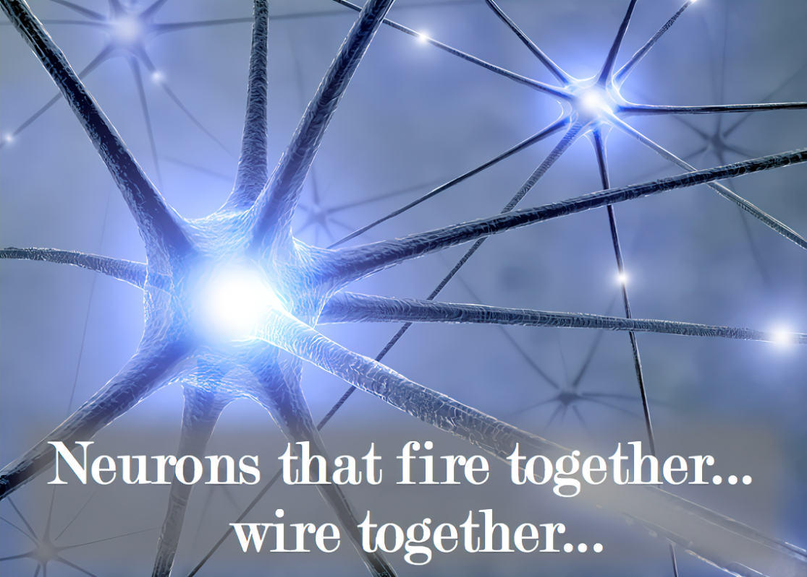
Notes:
Video transcript for this slide (Mollie Grow):
Neuroscience has shown us the mechanism of pausing and savoring positive memories strengthens neural pathways. In fact, we know from early childhood development that relationships are the primary way the neural connections are created in the limbic system where we process emotions. This remarkable plasticity of our brains is something we as pediatricians recognize every day in our patients. It is also true for us adults! Psychologists are showing ways we can take advantage of this neuroplasticity to cultivate and sustain positive emotions through mindful awareness, tuning into those good things around us - including connecting with people.
Pause to appreciate that positive connection we just shared minutes ago. Enjoy how that felt for another moment. Okay, we just did it-we practiced strengthening that pathway.

Slide 32
Positive Relationships
Accomplishment
Seligman, M. E. P. (2011). Flourish: A visionary new understanding of happiness and well-being. New York, NY: Free Press.
Notes:
Now we are going to dive into more detail about positive relationships and the connection with joy.

Slide 33
Relationships – meaning & joy
Our patients and their families
Our colleagues
Notes:
Video transcript for this slide (Maneesh) :
Thinking about the way people experience relationships in their work as pediatricians, we recognize two very important sets of relationships that present themselves in our day-to-day work. One is the relationships that we have with our patients and their families, and another is the relationships we have with our colleagues”
Thinking about the way people experience relationships in their work as pediatricians, we recognize two very important sets of relationships - our patients and their families, and our colleagues.

Slide 34
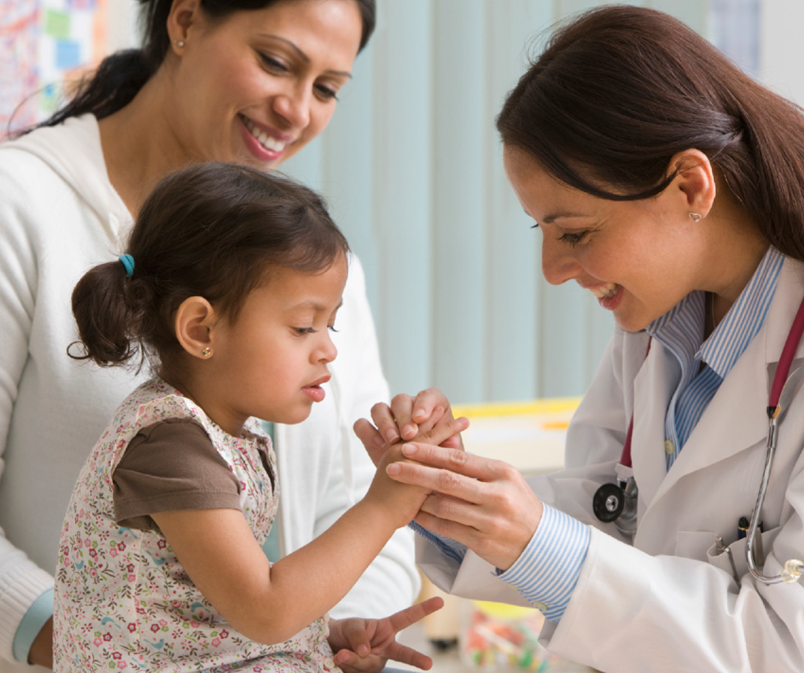
Patient relationships
“Strong relationships with patients also benefit the health of physicians.” – Dugdale LS, 2017
Within pediatrics, our calling to serve children and the connections with their joy and resilience drew many of us to our profession
In our best connections, we create moments of mutual delight
Notes:
Video transcript for this slide (Maneesh):
In studying patient relationships, Dugdale et al in their piece, entitled Physician Work Environment and Wellbeing, Re-enchanting Medicine, they described how strong relationships with patients also benefit the health of physicians. And within pediatrics, our calling to serve children and the connections with their joy and resilience is what drew many of us to our profession in the first place. And in our best connections, we create these moments of mutual delight.
Dugdale LS. Physician work environment and well-being: Re-enchanting medicine. JAMA Internal Medicine. 2017;177(8):1075–1076. (Dugdale, 2017, p. 1075).
Mutual delight / joy moments – these train our brains differently to build new pathways of plasticity for learning, effectively overcoming our problem of negativity bias

Slide 35
Colleague relationships
“Interpersonal relationships may serve a buffering role against stress by providing social support. Multiple studies have found that positive support from colleagues lowers the risk of burnout among clinicians.”
  National Academy of Sciences. “Taking Action Against Clinician Burnout”, 2019
Our brains’ mirror neurons - we experience “emotional contagion.”
“Feeling better after interacting with happy individuals” was associated with lower risk of burnout among physicians.
  Pettitta et al, 2017
Notes:
Video transcript for this slide (Maneesh):
Interpersonal relationships may serve as a buffering role against stress by providing social support. Multiple studies have found that positive support from colleagues lowers the risk of burnout among clinicians. This statement comes from the National Academy of Sciences “Taking Action Against Clinician Burnout” website, and document, which if you haven't checked out, is worth a little bit of time. When we asked people in our own Department of Pediatrics in an entire department-wide survey conducted a couple of years ago about the factor that contributed most to well-being among our faculty, the number one factor identified by our faculty that protected against burnout were their colleagues. From Pettitta et al work, we've learned also about the notion of emotional contagion, defined as perception of how one's own emotions are influenced by the emotions of colleagues. In this study, feeling better after interacting with happy individuals was associated with a lower risk of emotional exhaustion and depersonalization, which are two components of burnout in physicians. and a lower risk of depersonalization in nurses. Conversely, feeling irritated after interacting with angry individuals was associated with the opposite effects on burnout measures. So what can we collectively learn from these findings on colleague relationships? Well first, it makes sense to optimize the time with colleagues when we can. Second, our moment-to-moment interactions form the foundation of our relationships.
We all have negative ones we have to deal with daily and lots of potentially positive ones. In pediatrics, it's possible the vast majority are positive. Can we refine our abilities to recognize and focus on those positive ones? And if we can do this, at times, we potentially have the capacity to lift each other up, highlighting joy, being positive and appreciative. Finally, we have a choice for how we show up. Taking time to understand people's stories has the potential to change and evolve those relationships that are difficult or challenging. When we understand others, we connect with them differently. As Meg Wheatley said, you can't hate someone whose story you know. Connection and joy beget connection and joy.
National Academies of Sciences, National Academy of Medicine; Taking Action Against Clinician Burnout: A Systems Approach to Professional Well-Being. 2019. https://www.ncbi.nlm.nih.gov/books/NBK552615/?report=reader
Interpersonal relationships may serve a buffering role against stress by providing social support. Multiple studies have found that positive support from colleagues lowers the risk of burnout among clinicians (Adriaenssens et al., 2015b; Hyman et al., 2017; Pisanti, 2012; Pisanti et al., 2016b; Proost et al., 2004).
When we asked people in our Dept in a dept-wide survey, the #1 factor that contributed to well being among faculty and protected against burnout were their colleagues
Petitta and colleagues (2017) studied “emotional contagion,” defined as perception of how one's own emotions are influenced by the emotions of colleagues. In this study, “feeling better after interacting with happy individuals” was associated with a lower risk of emotional exhaustion and depersonalization in physicians and a lower risk of depersonalization in nurses. Conversely, feeling irritated after interacting with angry individuals was associated with the opposite effects on burnout measures.
Collectively what can we learn from these findings:
Optimize time with colleagues when we can.
Moment to moment interactions form foundation of relationships – we all have negative ones that we have to deal with, and lots of potential positive ones in pediatrics – perhaps vast majority are, can we refine our abilities to recognize and focus on those? And if we can do this at times, we potentially have the capacity to lift each other up – highlighting joy, being positive, appreciative.
We have a choice for how we show up. Taking time to understand peoples’ stories, has the potential to change and evolve those relationships that are difficult or challenging – when we understand others, we connect with them differently.
“You can’t hate someone whose story you know” – Meg Wheatley
Connection and joy begets connection and joy.

Slide 36
INDIVIDUAL ACTIVITY: Reflection on connecting with moments of joy
Reflect on a meaningful connection with a patient or colleague
  What were the joy moments of “mutual delight” you shared
  Why was it meaningful to you
  What allowed you to experience that connection at that time (e.g., setting, your frame of mind)
Reflect and write for 5 minutes
Notes:
Maneesh
Now we will engage in an activity to practice identifying and connecting with moments of joy through reflection
Slide is in handout and chat
In your day-to-day life, what can you do to notice the events that have meaning for you? What are the clues that let you know you have made that connection?

Slide 37
Any moments of mutual delight you’d like to share briefly?
Any reflections on what allowed you to experience those moments?
Surprises or insights?
Each of our stories unique and important.
Notes:
@ STREAM – leave this for facilitator? Voice over or silent?

Slide 38
7. Continuing with Joy

Slide 39
Cultivating Joy in our work through relationships: keeping this going
How do we connect with joy in relationships day-to-day?
How do we recognize those joy moments
  Make ourselves a little more Velcro for those!
Notes:
Video transcript for this slide (Mollie Grow):
This took about 15 minutes to do. Remarkably positive and affirming to hear about those moments from colleagues that shape our relationships with each other.
Call to action for our humanity as pediatricians: Reclaiming our relationships and our joy in the aftermath of COVID
How do we make ourselves able to be Velcro for these joy moments – to see them and savor them – even in the face of ongoing surges and challenges.

Slide 40
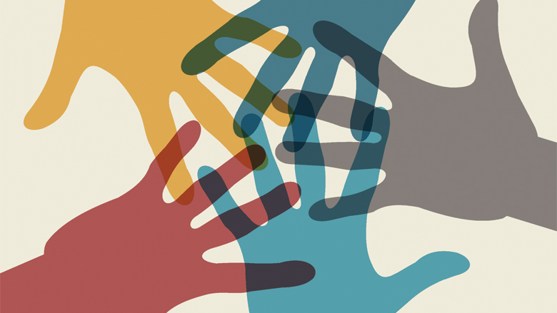
Everyday strategies
Meetings – build in time for personal sharing, check-ins
Junior mentor time before department faculty meetings
Peer mentor groups / writing groups
Engaging with each other in improving systems
Stairwell / hallway conversations
Celebrations - Birthdays and Retirements
Expressing gratitude for each other
Notes:
Video transcript for this slide (Mollie Grow):
We recognize that this is very much a work in progress for all of us. We wanted to highlight a few strategies that may be valuable opportunities for cultivating relationships and having these conversations. We hope that it doesn't necessarily feel like a separate thing that we have to do and then it's not always a lot of time for the value that we experience with them.
Hopefully, we can try to overcome some of the guilty feeling that connecting and sharing our stories is a waste of time. Building protective relationships buffers the stress of our work. As our cardiology colleagues may recognize, this is our diastole time. Our hearts can't pump if they don't fill. We need diastole moments so that we can do systole. Some of these strategies have worked very well for us in our team, including having time in meetings and a junior mentor time before department faculty meetings. There are peer mentor groups and writing groups that have helped people to connect. Certainly engaging with each other and improving systems is a way to collaborate and build our capacity for those conversations and relationships. And simply the stairwell and hallway conversations and hopefully some celebrations along the way.
And the day-to-day expressing gratitude for one another. These are all part of the ways that we can do this work together.

Slide 41
GROUP ACTIVITY: Making Space for Joy
How do we overcome our natural negativity bias and be more Velcro to moments?
When you have a joyful experience how do you help yourself absorb, acknowledge, and/or metabolize that joy?
What can we do collectively to intentionally make space to recognize and celebrate joy moments?
5 minutes
Notes:
5 min
Group discussion –
Any of the ideas Mollie share resonate? Other ideas? How can we schedule time for this?

Slide 42
8. Wrap up

Slide 43
Wrap Up – Joy and Meaning
Knowing our own story and each other’s stories
Recognize how relationships nourish us
Practice makes progress!
  Curiosity
  Vulnerability
  Gratitude
“There is no hope of joy except in human relations”
-Antoine de Saint Exupery
Notes:
Video transcript for this slide (Mollie Grow):
As we wrap up this segment on joy and the preceding section on meaning, we want to emphasize that knowing our own story and each other's stories is so powerful for our ability to connect. We recognize how relationships nourish us and provide us many of the joy moments of our lives. Like the other parts of medicine, this all takes practice. Practice makes progress. We will never be perfect, nor will our systems. We can bring our curiosity and vulnerability and our gratitude for each other as we journey together through our careers in pediatrics. Hopefully, we can pause and ask each other the questions.
What was a meaningful or joyful part of your day today?
Who did you get to connect with?
And we'll continue to have our chance of having joy in these human relationships.

Slide 44
Turning to One Another
Margaret Wheatley, 2002
There is no power greater than a community discovering what it cares about.
Ask “What’s possible?” not “What’s wrong?” Keep asking.
Notice what you care about.
Assume that many others share your dreams.
Be brave enough to start a conversation that matters.
Talk to people you know.
Talk to people you don’t know.
Talk to people you never talk to.
Be intrigued by the differences you hear.
Expect to be surprised.
Treasure curiosity more than certainty.
Invite in everybody who cares to work on what’s possible.
Acknowledge that everyone is an expert about something.
Know that creative solutions come from new connections.
Remember, you don’t fear people whose story you know.
Real listening always brings people closer together.
Trust that meaningful conversations can change your world.
Rely on human goodness. Stay together.
Notes:
Video transcript for this slide (Mollie Grow):
We will finish with a poem of affirmation. Hopefully a chance to think about how we aspire to these values. This is Turning to One Another by Margaret Wheatley.
There is no power greater than a community discovering what it cares about.
Ask what's possible, not what's wrong. Keep asking.
Notice what you care about.
Assume that many others share your dreams.
Be brave enough to start a conversation that matters.
Talk to people you know.
Talk to people you don't know.
Talk to people you never talked to.
Be intrigued by the differences you hear.
Expect to be surprised.
Treasure curiosity more than certainty.
Invite in everybody who cares to work on what's possible.
Acknowledge that everyone is an expert about something.
Know that creative solutions come from new connections.
Remember, you don't fear people whose story you know.
Real listening always brings people closer together.
Trust that meaningful conversations can change your world.
Rely on human goodness. Stay together.

Slide 45
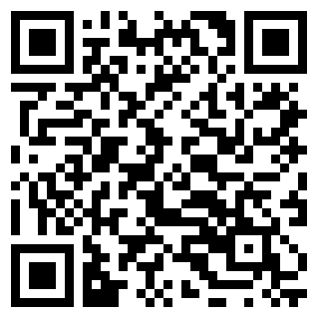
Thank you!
We want your feedback!
Help us by completing this short 3 question evaluation
We will also send a very short survey in 2 weeks.

