Slide 1



Joy in Medicine
Created by: Maneesh Batra, MD, Mollie Grow, MPH, MD
Notes:
Videos 18.5 min 34 min
Mollie Grow is a general pediatrician and associate program director of the University of Washington Pediatrics Residency program
Maneesh Batra is the interim chief of neonatology at the University of Washington school of medicine department of pediatrics and a former program residency director at the University of Washington school of medicine
Option to share:
Your (division chief/manager/etc) invited us here to talk about joy in medicine because they care about your well-being. We are excited to present this session to you which was developed through a HRSA grant.
Change Notes-
Updates from previous: QR code attendance & QR code post survey, numbered sections, leadership note, twitter handle

Slide 2

Please complete for attendance
Notes:
Videos 18.5 min 34 min
Mollie Grow is a general pediatrician and associate program director of the University of Washington Pediatrics Residency program
Maneesh Batra is the interim chief of neonatology at the University of Washington school of medicine department of pediatrics and a former program residency director at the University of Washington school of medicine
Option to share:
Your (division chief/manager/etc) invited us here to talk about joy in medicine because they care about your well-being. We are excited to present this session to you which was developed through a HRSA grant.
Change Notes-
Updates from previous: QR code attendance & QR code post survey, numbered sections, leadership note, twitter handle

Slide 3





Connecting with Joy & Meaning in Medicine
Promoting Your Well-Being
Building Resilience
Engaging with Peers to Improve Systems
Notes:
Our STREAM model incorporates four areas where we can work to improve our overall wellness: Well-Being, Resilience, Engagement and Joy and Meaning in Medicine

Slide 4
PERMAH
Positive Relationships
Positive Emotions
Meaning
Accomplishment
Seligman, M. E. P. (2011). Flourish: A visionary new understanding of happiness and well-being. New York, NY: Free Press.
Notes:
This is the PERMAH model of wellbeing from Seligman we are using in STREAM to conceptualize overall wellness. We want to highlight the individual and systemic opportunities we have to increase our chances of FLOURISHING in challenging circumstances.
This particular session will be focusing on connecting with our meaning and the joy of positive relationships that allows us to experience positive emotion.

Slide 5
Listen Respectfully
Practice Holding Complex Thought
Fully Participate
Rules of Engagement
Respect & Maintain Confidentiality
Speak From Own Experience
Be Open To New & Different Perspectives
Notes:
We hope that you all are able to be active participants today – that you’ll engage in both the reflective and the conversational elements of this session. And we also want to acknowledge that some of the tools that we’re using today take time, that reflection isn’t easy at a moments notice, but we hope that you’ll try to take this little leap with us…..

Slide 6



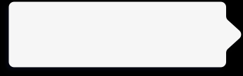
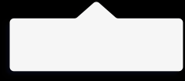
Objectives:
Emphasize relationships with patients and colleagues as a way to amplify joy as a pediatrician
Why is Joy important?
1
3
Practice connecting with Joy today
2
How to continue to cultivate Joy
Notes:
.
Today’s main objective is to “emphasize relationships with…”. We will start by talking about why joy is important, give you some to time to practice connecting with joy and end with some ideas on ways to continue this important work.

Slide 7
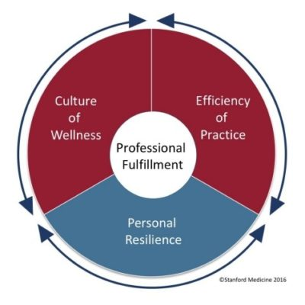
You practice in a flawed medical system
“Up to 80% of the causes of physician dissatisfaction and lack of well-being are systems issues” (Collier, R. CMAJ 2018)
Leading models of physician stress support the
Concept that addressing systems issues will
Have the greatest impact on physician wellness
Stanford Medicine Model of Wellness (2016)

Slide 8
Systems that Influence Individual Well-Being
Procedures, laws, regulations
Policy
Environmental structure, safety, access to health services
(Cultural values, norms)
Community
Work culture, efficiency of practice, values, goals
(formal and informal rules, operations)
Organizational
Friends, neighbors, co-workers, family
(social network)
Interpersonal
Physical, psychological, cognitive, spiritual
(knowledge, behaviors, skills)
Personal
Notes:
Individual well-being is complex interaction between personal level experiences, behaviors, and thoughts. Within the socioecologic model, each level adds it’s own layer of complexity.
Situating individual well-being

Slide 9
It’s easy to feel overwhelmed by the dysfunctional system
Notes:
Option 1: It’s easy to be overwhelmed by the dysfunctional system. However, you are part of the system. You can impact the system at multiple points of contact and those points can influence other points. Eventually, the system can work differently, which is the goal. All of the systems factors are important. Being in the practice of medicine is our calling and part of that is walking into other’s suffering everyday. We still need individual well-being strategies to while we also address the system factors so that we can still show up while we are working on changing the system. In STREAM, we want to challenge you to consider how you can apply (well-being, resilience, engagement, joy, meaning) strategies both to yourself and your work system.
Option 2: Raise you hand if you want the system to change, raise your hand if you want to be miserable while you wait. If we focus on individuals, we change how we show up to out work. This can make a very large impact and you have a choice!

Slide 10
Joy and Inclusion
We actively seek to promote inclusion through our connections.
We welcome all to fully participate and benefit from cultivating a sense of well-being in our professional work
This concept should not be exclusive to those afforded particular privileges
Including all identities in experiencing joy and meaning through our stories and reflections allows us to grow, and to celebrate and deepen our connections to our patients, colleagues and our profession
Notes:
Video transcript for this slide (Mollie Grow):
In discussing joy and its alignment with a sense of inclusion, we see connections as a primary way that we promote inclusion, and we welcome all to fully participate and benefit from cultivating a sense of well-being in our professional work. When we talk about full and active participation, we want to specifically call out that we hope to promote that sense of inclusion for everyone who comes to these sessions. Including all identities and experiencing joy and meaning through our stories and reflections allows us to grow and to celebrate and deepen our connections to our patients, colleagues, and our profession. Much of the work that we do together will be through sharing our stories and sharing our thoughts and reflections on each other's stories.
We know that all of us will benefit and all of us will be enriched if we can create the kind of space that everyone feels safe to share what matters most to them.

Slide 11
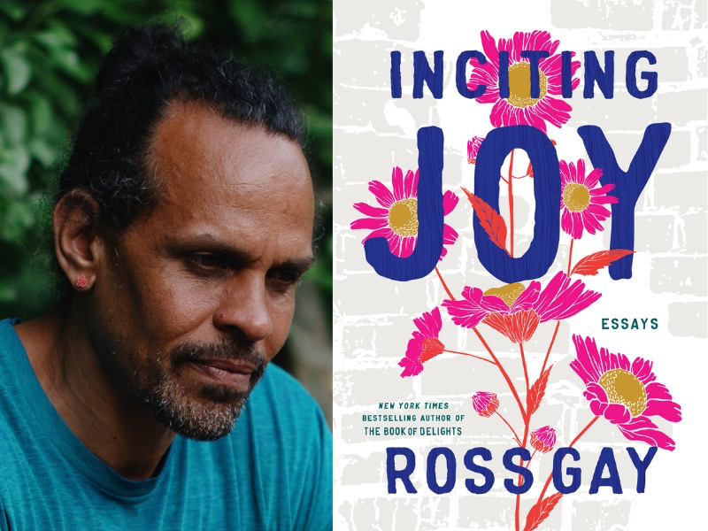
Invitation and welcome
“What if joy is not only entangled with pain, or suffering, or sorrow, but is also what emerges from how we care for each other through these things? What if joy, instead of refuge or relief from heartbreak, is what effloresces from us as we help each other carry our heartbreaks?”
-Ross Gay “Inciting Joy”
Notes:
we hope to have a space to reflect on how joy may show up differently for each of us. In some ways, the concept of joy may feel almost loaded and even unattainable in our current state of the world. The word joy might invoke simply a state of bliss or privilege or some beach vacation. However, we felt it would be helpful to offer an expanded view of what joy may mean. Poet Ross Gay, in his collection of essays inciting joy, shared this in his writing. What if joy is not only entangled with pain or suffering or sorrow, but is also what emerges from how we care for each other through these things? What if joy, instead of refuge or relief from heartbreak,
is what effloresces from us as we help each other carry our heartbreaks. It feels very important to reclaim joy, maybe not so much as a sense of ecstasy, but more aligned with calling forth our meaning and connection, particularly in the heartache experienced by many dealing with losses from COVID and racism. There are a multitude of ways in which joy can be shared through our connections, that we may hold the heartbreak in our professional work and a sense of joy at the same time as a both and phenomenon is possible.

Slide 12
PARTNER ACTIVITY:
Reflect on a moment of positive connection with someone recently
Think about who you shared that moment with and share what made it joyful.
4 minutes
Please complete for attendance
(if you haven’t already done so)
Notes:
4 min
Mollie
SO to jump start focusing on joy moments, we offer a chance to call to mind a moment of positive connection with someone recently.
Think about who you shared that moment with and what made it joyful.
Post in the chat
Diane and Shug share an example

Slide 13


1. Positive impact of Joy

Slide 14
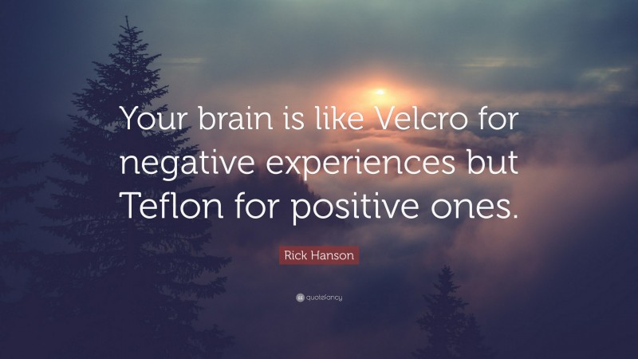
Notes:
Video transcript for this slide (Mollie Grow):
One of our team’s favorite quotes related to STREAM is this one from psychologist Rick Hanson, “Your brain is like Velcro for negative experiences but Teflon for positive ones.” This very apt phrase links to content from prior STREAM sessions on mental health and Resilience.
With negativity bias, our minds are wired to hang onto the bad outcomes, and overlook the good ones. We may have 100’s of positive patient encounters, but dwell on the one negative one.
The good news is there is a way to overcome this bias. When we pause to reflect on happy or positive moments, such as those we share with others, we strengthen the memory. While it takes intentional effort, lots of literature shows us it is possible – foundation of cognitive behavioral therapy (CBT) – teaching our brains to see and interpret differently. Just like exercise, it’s lifelong practice to experience the benefits.

Slide 15
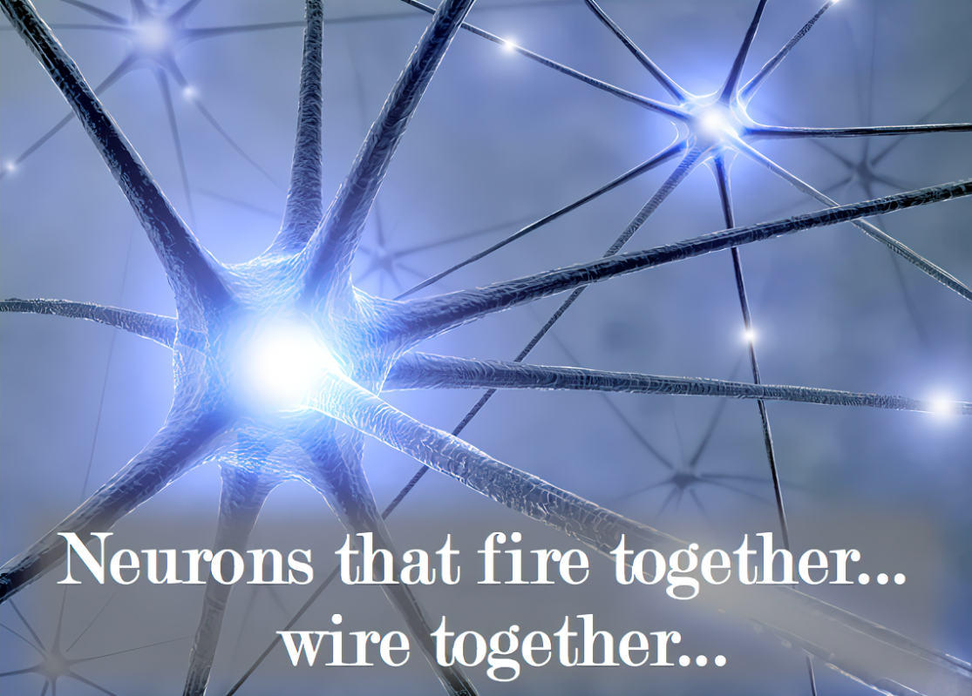
Notes:
Video transcript for this slide (Mollie Grow):
Neuroscience has shown us the mechanism of pausing and savoring positive memories strengthens neural pathways. In fact, we know from early childhood development that relationships are the primary way the neural connections are created in the limbic system where we process emotions. This remarkable plasticity of our brains is something we as pediatricians recognize every day in our patients. It is also true for us adults! Psychologists are showing ways we can take advantage of this neuroplasticity to cultivate and sustain positive emotions through mindful awareness, tuning into those good things around us - including connecting with people.
Pause to appreciate that positive connection we just shared minutes ago. Enjoy how that felt for another moment. Okay, we just did it-we practiced strengthening that pathway.

Slide 16
Positive Relationships
Accomplishment
Seligman, M. E. P. (2011). Flourish: A visionary new understanding of happiness and well-being. New York, NY: Free Press.
Notes:
Now we are going to dive into more detail about positive relationships and the connection with joy.

Slide 17
Relationships – meaning & joy
Our patients and their families
Our colleagues
Notes:
Video transcript for this slide (Maneesh) :
“Thinking about the way people experience relationships in their work as pediatricians, we recognize two very important sets of relationships that present themselves in our day-to-day work. One is the relationships that we have with our patients and their families, and another is the relationships we have with our colleagues”
Thinking about the way people experience relationships in their work as pediatricians, we recognize two very important sets of relationships - our patients and their families, and our colleagues.

Slide 18
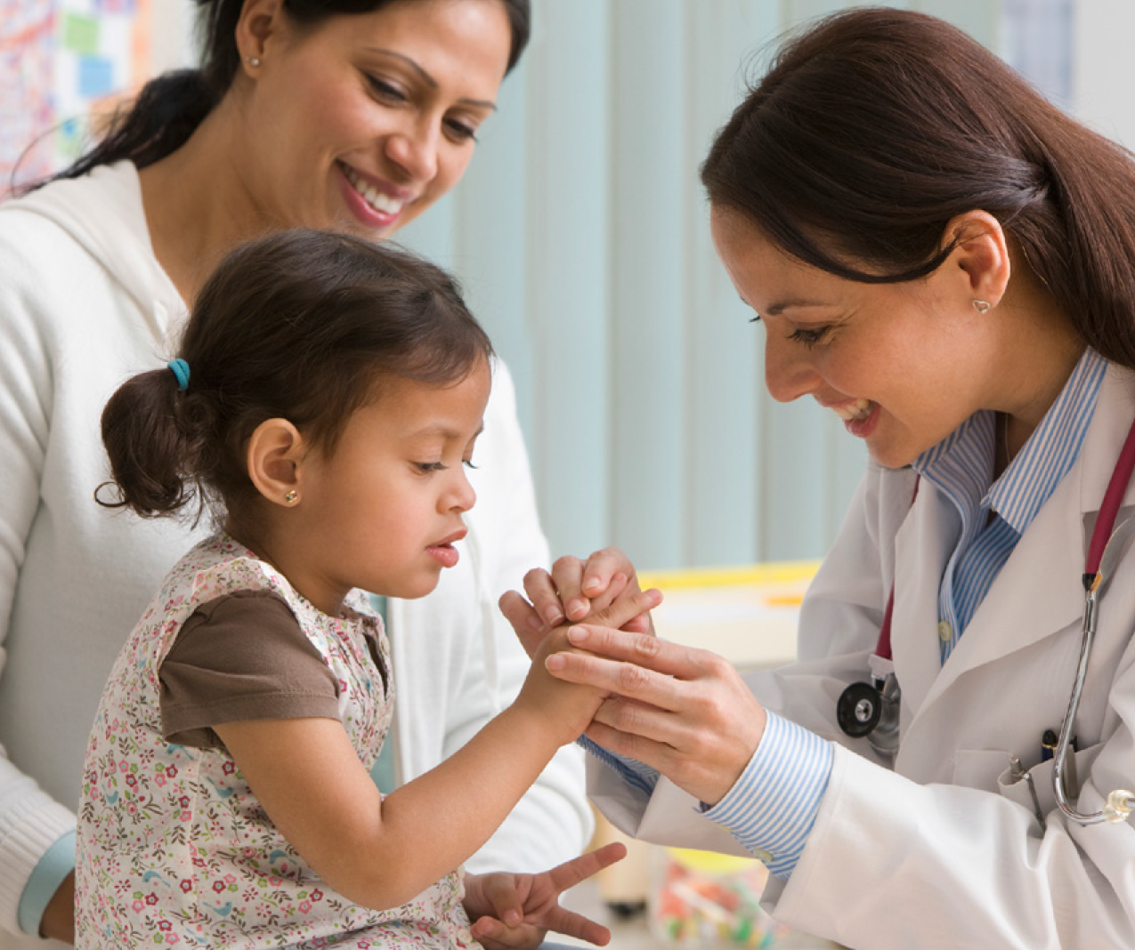
Patient relationships
“Strong relationships with patients also benefit the health of physicians.” – Dugdale LS, 2017
Within pediatrics, our calling to serve children and the connections with their joy and resilience drew many of us to our profession
In our best connections, we create moments of mutual delight
Notes:
Video transcript for this slide (Maneesh):
“In studying patient relationships, Dugdale et al in their piece, entitled Physician Work Environment and Wellbeing, Re-enchanting Medicine, they described how strong relationships with patients also benefit the health of physicians. And within pediatrics, our calling to serve children and the connections with their joy and resilience is what drew many of us to our profession in the first place. And in our best connections, we create these moments of mutual delight. “
Dugdale LS. Physician work environment and well-being: Re-enchanting medicine. JAMA Internal Medicine. 2017;177(8):1075–1076. (Dugdale, 2017, p. 1075).
Mutual delight / joy moments – these train our brains differently to build new pathways of plasticity for learning, effectively overcoming our problem of negativity bias

Slide 19
Colleague relationships
“Interpersonal relationships may serve a buffering role against stress by providing social support. Multiple studies have found that positive support from colleagues lowers the risk of burnout among clinicians.”
  National Academy of Sciences. “Taking Action Against Clinician Burnout”, 2019
Our brains’ mirror neurons - we experience “emotional contagion.”
“Feeling better after interacting with happy individuals” was associated with lower risk of burnout among physicians.
  Pettitta et al, 2017
Notes:
Video transcript for this slide (Maneesh):
Interpersonal relationships may serve as a buffering role against stress by providing social support. Multiple studies have found that positive support from colleagues lowers the risk of burnout among clinicians. This statement comes from the National Academy of Sciences “Taking Action Against Clinician Burnout” website, and document, which if you haven't checked out, is worth a little bit of time. When we asked people in our own Department of Pediatrics in an entire department-wide survey conducted a couple of years ago about the factor that contributed most to well-being among our faculty, the number one factor identified by our faculty that protected against burnout were their colleagues. From Pettitta et al work, we've learned also about the notion of emotional contagion, defined as perception of how one's own emotions are influenced by the emotions of colleagues. In this study, feeling better after interacting with happy individuals was associated with a lower risk of emotional exhaustion and depersonalization, which are two components of burnout in physicians. and a lower risk of depersonalization in nurses. Conversely, feeling irritated after interacting with angry individuals was associated with the opposite effects on burnout measures. So what can we collectively learn from these findings on colleague relationships? Well first, it makes sense to optimize the time with colleagues when we can. Second, our moment-to-moment interactions form the foundation of our relationships.
We all have negative ones we have to deal with daily and lots of potentially positive ones. In pediatrics, it's possible the vast majority are positive. Can we refine our abilities to recognize and focus on those positive ones? And if we can do this, at times, we potentially have the capacity to lift each other up, highlighting joy, being positive and appreciative. Finally, we have a choice for how we show up. Taking time to understand people's stories has the potential to change and evolve those relationships that are difficult or challenging. When we understand others, we connect with them differently. As Meg Wheatley said, you can't hate someone whose story you know. Connection and joy beget connection and joy.
National Academies of Sciences, National Academy of Medicine; Taking Action Against Clinician Burnout: A Systems Approach to Professional Well-Being. 2019. https://www.ncbi.nlm.nih.gov/books/NBK552615/?report=reader
Interpersonal relationships may serve a buffering role against stress by providing social support. Multiple studies have found that positive support from colleagues lowers the risk of burnout among clinicians (Adriaenssens et al., 2015b; Hyman et al., 2017; Pisanti, 2012; Pisanti et al., 2016b; Proost et al., 2004).
When we asked people in our Dept in a dept-wide survey, the #1 factor that contributed to well being among faculty and protected against burnout were their colleagues
Petitta and colleagues (2017) studied “emotional contagion,” defined as perception of how one's own emotions are influenced by the emotions of colleagues. In this study, “feeling better after interacting with happy individuals” was associated with a lower risk of emotional exhaustion and depersonalization in physicians and a lower risk of depersonalization in nurses. Conversely, feeling irritated after interacting with angry individuals was associated with the opposite effects on burnout measures.
Collectively what can we learn from these findings:
Optimize time with colleagues when we can.
Moment to moment interactions form foundation of relationships – we all have negative ones that we have to deal with, and lots of potential positive ones in pediatrics – perhaps vast majority are, can we refine our abilities to recognize and focus on those? And if we can do this at times, we potentially have the capacity to lift each other up – highlighting joy, being positive, appreciative.
We have a choice for how we show up. Taking time to understand peoples’ stories, has the potential to change and evolve those relationships that are difficult or challenging – when we understand others, we connect with them differently.
“You can’t hate someone whose story you know” – Meg Wheatley
Connection and joy begets connection and joy.

Slide 20
PARTNER ACTIVITY: Reflection on connecting
with moments of joy
Reflect on a meaningful connection with a patient or colleague
  What were the joy moments of “mutual delight” you shared
  Why was it meaningful to you
  What allowed you to experience that connection at that time (e.g., setting, your frame of mind)
Reflect and write for 5 minutes
Pair-share for 10 minutes (5 min for each person)
Notes:
Now we will engage in an activity to practice identifying and connecting with moments of joy through reflection

Slide 21
Any moments of mutual delight you’d like to share briefly?
Any reflections on what allowed you to experience those moments?
Surprises or insights?
Each of our stories unique and important.

Slide 22
2. Continuing with Joy

Slide 23
Cultivating Joy in our work through relationships: keeping this going
How do we connect with joy in relationships day-to-day?
How do we recognize those joy moments
  Make ourselves a little more Velcro for those!
Notes:
Video transcript for this slide (Mollie Grow):
This took about 15 minutes to do. Remarkably positive and affirming to hear about those moments from colleagues that shape our relationships with each other.
Call to action for our humanity as pediatricians: Reclaiming our relationships and our joy in the aftermath of COVID
How do we make ourselves able to be Velcro for these joy moments – to see them and savor them – even in the face of ongoing surges and challenges.

Slide 24
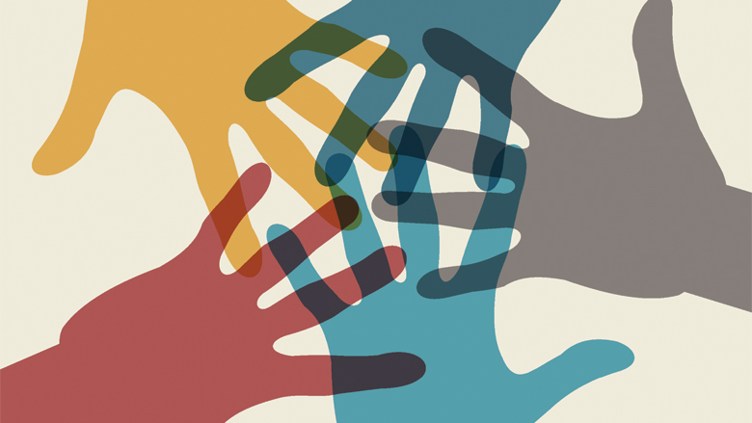
Everyday strategies
Meetings – build in time for personal sharing, check-ins
Junior mentor time before department faculty meetings
Peer mentor groups / writing groups
Engaging with each other in improving systems
Stairwell / hallway conversations
Celebrations - Birthdays and Retirements
Expressing gratitude for each other
Notes:
Video transcript for this slide (Mollie Grow):
We recognize that this is very much a work in progress for all of us. We wanted to highlight a few strategies that may be valuable opportunities for cultivating relationships and having these conversations. We hope that it doesn't necessarily feel like a separate thing that we have to do and then it's not always a lot of time for the value that we experience with them.
Hopefully, we can try to overcome some of the guilty feeling that connecting and sharing our stories is a waste of time. Building protective relationships buffers the stress of our work. As our cardiology colleagues may recognize, this is our diastole time. Our hearts can't pump if they don't fill. We need diastole moments so that we can do systole. Some of these strategies have worked very well for us in our team, including having time in meetings and a junior mentor time before department faculty meetings. There are peer mentor groups and writing groups that have helped people to connect. Certainly engaging with each other and improving systems is a way to collaborate and build our capacity for those conversations and relationships. And simply the stairwell and hallway conversations and hopefully some celebrations along the way.
And the day-to-day expressing gratitude for one another. These are all part of the ways that we can do this work together.

Slide 25
GROUP ACTIVITY: Making Space for Joy
How do we overcome our natural negativity bias and be more Velcro to moments?
When you have a joyful experience how do you help yourself absorb, acknowledge, and/or metabolize that joy?
What can we do collectively to intentionally make space to recognize and celebrate joy moments?
5 minutes
Notes:
5 min
Group discussion –

Slide 26
3. Wrap up

Slide 27
Wrap Up – Joy and Meaning
Knowing our own story and each other’s stories
Recognize how relationships nourish us
Practice makes progress!
  Curiosity
  Vulnerability
  Gratitude
“There is no hope of joy except in human relations”
-Antoine de Saint Exupery
Notes:
Video transcript for this slide (Mollie Grow):
As we wrap up this segment on joy and the preceding section on meaning, we want to emphasize that knowing our own story and each other's stories is so powerful for our ability to connect. We recognize how relationships nourish us and provide us many of the joy moments of our lives. Like the other parts of medicine, this all takes practice. Practice makes progress. We will never be perfect, nor will our systems. We can bring our curiosity and vulnerability and our gratitude for each other as we journey together through our careers in pediatrics. Hopefully, we can pause and ask each other the questions. What was a meaningful or joyful part of your day today? Who did you get to connect with?
And we'll continue to have our chance of having joy in these human relationships.

Slide 28
Turning to One Another
Margaret Wheatley, 2002
There is no power greater than a community discovering what it cares about.
Ask “What’s possible?” not “What’s wrong?” Keep asking.
Notice what you care about.
Assume that many others share your dreams.
Be brave enough to start a conversation that matters.
Talk to people you know.
Talk to people you don’t know.
Talk to people you never talk to.
Be intrigued by the differences you hear.
Expect to be surprised.
Treasure curiosity more than certainty.
Invite in everybody who cares to work on what’s possible.
Acknowledge that everyone is an expert about something.
Know that creative solutions come from new connections.
Remember, you don’t fear people whose story you know.
Real listening always brings people closer together.
Trust that meaningful conversations can change your world.
Rely on human goodness. Stay together.
Notes:
Video transcript for this slide (Mollie Grow):
We will finish with a poem of affirmation. Hopefully a chance to think about how we aspire to these values. This is Turning to One Another by Margaret Wheatley.
There is no power greater than a community discovering what it cares about.
Ask what's possible, not what's wrong. Keep asking.
Notice what you care about.
Assume that many others share your dreams.
Be brave enough to start a conversation that matters.
Talk to people you know.
Talk to people you don't know.
Talk to people you never talked to.
Be intrigued by the differences you hear.
Expect to be surprised.
Treasure curiosity more than certainty.
Invite in everybody who cares to work on what's possible.
Acknowledge that everyone is an expert about something.
Know that creative solutions come from new connections.
Remember, you don't fear people whose story you know.
Real listening always brings people closer together.
Trust that meaningful conversations can change your world.
Rely on human goodness. Stay together.

Slide 29

Thank you!
We want your feedback!
Help us by completing this short 3 question evaluation
We will also send a very short survey in 2 weeks
Additional resources are on the handout if you need more support

