Slide 1



Engagement with Peers
to Improve Systems
Created by:
Dr. Suzanne Reed & Dr. John Mahan
Notes:
26 minutes of videos, 53 minutes activities
Option to share:
Your (division chief/manager/etc) invited us here to talk about engangement with system improvements because they care about your well-being. We are excited to present this session to you which was developed through a HRSA grant.
Change Notes-
Updates from previous: QR code attendance & QR code post survey, numbered sections, leadership note, twitter handle

Slide 2

Please complete for attendance
Notes:
26 minutes of videos, 53 minutes activities
Option to share:
Your (division chief/manager/etc) invited us here to talk about engangement with system improvements because they care about your well-being. We are excited to present this session to you which was developed through a HRSA grant.
Change Notes-
Updates from previous: QR code attendance & QR code post survey, numbered sections, leadership note, twitter handle

Slide 3





Connecting with Joy & Meaning in Medicine
Promoting Your Well-Being
Building Resilience
Engaging with Peers to Improve Systems
Notes:
Our STREAM model incorporates four areas where we can work to improve our overall wellness: Well-Being, Resilience, Engagement and Joy and Meaning in Medicine

Slide 4
Rules of Engagement
Listen Respectfully
Fully Participate
Speak From Own Experience
Respect & Maintain Confidentiality
Practice Holding Complex Thought
Be Open To New & Different Perspectives
Notes:
We want everyone to participate during this session, be respectful and open to new ideas.

Slide 5



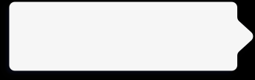
Objectives:
Identify explicit ways to become involved in systems-improvement efforts in your own organization
Appreciate relationship between physician engagement and overall wellness
3
1
Reflect on areas of personal importance in work that contribute to own/colleagues’ stress/burnout
2

Slide 6
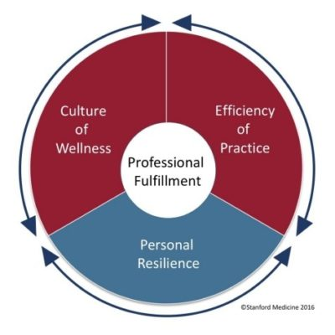
You practice in a flawed medical system
“Up to 80% of the causes of physician dissatisfaction and lack of well-being are systems issues” (Collier, R. CMAJ 2018)
Leading models of physician stress support the
concept that addressing systems issues will
have the greatest impact on physician wellness
Stanford Medicine Model of Wellness (2016)

Slide 7
Systems that Influence Individual Well-Being
Procedures, laws, regulations
Policy
Environmental structure, safety, access to health services
(Cultural values, norms)
Community
Work culture, efficiency of practice, values, goals
(formal and informal rules, operations)
Organizational
Friends, neighbors, co-workers, family
(social network)
Interpersonal
Physical, psychological, cognitive, spiritual
(knowledge, behaviors, skills)
Personal
Notes:
Individual well-being is complex interaction between personal level experiences, behaviors, and thoughts. Within the socioecologic model, each level adds it’s own layer of complexity.

Slide 8
It’s easy to feel overwhelmed by the dysfunctional system
Notes:
Option 1: It’s easy to be overwhelmed by the dysfunctional system. However, you are part of the system. You can impact the system at multiple points of contact and those points can influence other points. Eventually, the system can work differently, which is the goal. All of the systems factors are important. Being in the practice of medicine is our calling and part of that is walking into other’s suffering everyday. We still need individual well-being strategies to while we also address the system factors so that we can still show up while we are working on changing the system. In STREAM, we want to challenge you to consider how you can apply (well-being, resilience, engagement, joy, meaning) strategies both to yourself and your work system.
Option 2: Raise you hand if you want the system to change, raise your hand if you want to be miserable while you wait. If we focus on individuals, we change how we show up to out work. This can make a very large impact and you have a choice!

Slide 9

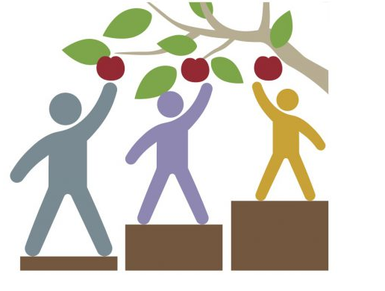
Equity and Engagement
True equity involves providing help and resources as they are needed, not necessarily providing the same to everyone.
Collaborating to improve your work environment and process can help us ensure that everyone, health care professionals and patients/families, have what they need to be successful and thrive.
Notes:
Video Transcription for this slide (John Mahan):
One of the benefits of engagement, we believe, is the opportunity to really promote equity for ourselves, our colleagues and our patients and families. True equity involves providing help and resources as they are needed, not necessarily providing the same to everyone. And we believe through this process of engagement, we can really pay attention to what different individuals need to be able to thrive and do well. We also believe that collaborating to improve the work environment and the work processes can help us as professionals ensure that everyone, ourselves, our colleagues, and patients and families have what they need to be successful and thrive. So in this sense, engagement can really be part of our pathway to equity.

Slide 10
PARTNER ACTIVITY: Discussion
What is engagement?
  What does it mean to you?
  Your personal experience or observation
  Did you notice a positive impact on your well being?
4 min

Slide 11
What is Engagement?
1. Engagement in Work
  Utrecht Work Engagement Scale (culture)
  At my work, I feel bursting with energy
  I am enthusiastic about my job
  I am immersed in my work
2. Engagement in Process/Work Improvement
  Involvement in QI, business process improvement, divisional activities
Among physicians with high levels of burnout, engaged physicians -
more satisfied with career and more likely to stay in current position
Notes:
JDM

Slide 12

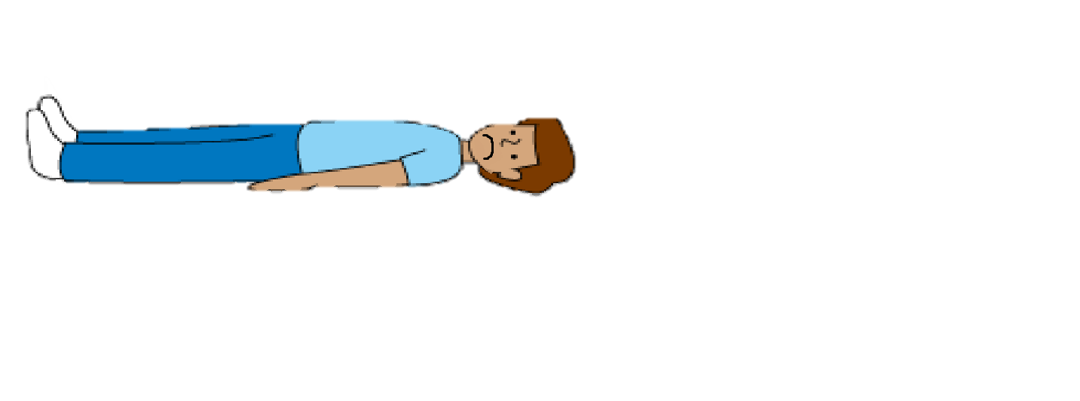
Did someone say “engagement?”
II can’t hear (or move) because of this giant bear covering my ears (and crushing me)
Hi, My Name Is
Medicine
Notes:
Many physicians feel like this, for a lot of reasons. We’ll talk about starting to lift this weight in a bit, but lets start with what is engagement and why is matters.
Want to acknowledge this feeling, and the idea of “doing” more when we’re already “doing” so much

Slide 13
PERMAH
Engagement
Accomplishment
¹ Seligman, M. E. P. (2011). Flourish: A visionary new understanding of happiness and well-being. New York, NY: Free Press.
Notes:
This is the PERMAH model we are using in STREAM from Seligman. This section specifically will focus on engagement from a perspective of improving work systems. We also will talk about how engaging with peers helps us experience well-being by strengthening positive relationships and how actually accomplishing something helps us feel good.

Slide 14

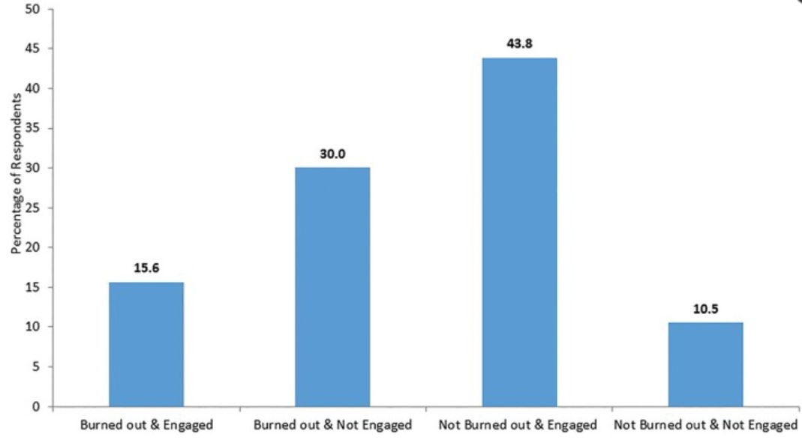
Rao SK, et. al., Clinical Medicine & Research 2020
Utrecht Work Engagement Scale: ‘engaged’ = scored high on 2/3 subscales: vigor, dedication, and absorption
After controlling for burnout, engagement improved career satisfaction and likelihood of staying in that practice
Notes:
Video Transcription for this slide (John Mahan):
Rao and colleagues looked at physician burnout and engagement and career satisfaction in a large academic medical practice. This was actually at Mass General. And among the different almost 2,000 physicians that participated in the survey, there was a subgroup that were burned out but engaged, another group that was burned out but not engaged, the largest group that were not burned out and were engaged, and then lastly, a group that were not burned out and not engaged. Rao and colleagues found was that using the Utrecht work engagement scale, again, looking at some of these questions that relate to vigor, dedication, absorption in their work, by definition, if individuals scored high in two of these three subscales, they were considered engaged. And again, after controlling for burnout, engagement improved career satisfaction and the likelihood of staying in that practice for this large group of almost 2,000 physicians.
And who among us would not want to feel engaged in what we're doing, feel good about our choice in our career, and feel good about the place we're working at and intend to want to stay in that place because we believe it is meeting our needs as well as allowing us to accomplish important things.
Rao Curr Med Sci 2020 [Mass General]
Of eligible physicians (n=1882), 92.0% completed a survey. High levels of engagement and burnout were shown in 59.5% and 45.6%, respectively. Compared to physicians with high levels of engagement and low levels of burnout, physicians with low engagement and low burnout were less satisfied with their career (OR=0.20, 95% CI=0.11-0.35) and less likely to stay in their current role (OR=0.52, 95% CI= 0.37-0.73). Among physicians with high levels of burnout, highly engaged physicians were more satisfied (OR=0.21; 95% CI=0.12-0.36 vs OR=0.08; 95% CI=0.05-0.12) and more likely to stay in their career (OR=0.34; 95% CI=0.25-0.45 vs OR=0.27; 95% CI=0.21-0.34) than non-engaged physicians.
Conclusion: Engaged physicians have higher career satisfaction. There are many actionable ways to improve engagement.
Work engagement: assessed using the Utrecht Work Engagement Scale. Physicians were considered ‘engaged’ if they scored high on two of three subscales: vigor, dedication, and absorption.

Slide 15
Moving Away from Engagement as Happenstance
Mayo Clin Proc 2017
Engagement (vigor, dedication, absorption in work) as antidote to Burnout
Organizations and Leaders can implement effective interventions to promote engagement
Notes:
Video Transcription for this slide (John Mahan):
This has been recognized by leaders in medicine and in a recent paper by Shannon Felt and colleagues, they identified the fact that going into engagement and engaging physicians really can be a priority for institutional leaders and institutions, recognizing that engagement is really an antidote to stress and burnout. And they really called out organizations and leaders to implement effective interventions to promote engagement, recognizing this very positive benefit.
JDM
Mayo Proc 2017
Work engagement: assessed using the Utrecht Work Engagement Scale. Physicians were considered ‘engaged’ if they scored high on two of three subscales: vigor, dedication, and absorption.

Slide 16



1. Engagement is
good– Now what?

Slide 17
So, just BE engaged. Right?
I love medicine, but it feels kind of…heavy?
Notes:
Video transcript for this slide (Suzie Reed):
So we've been talking about engagement and how engagement really fosters well-being in physicians. So I guess the answer is simple. Just be engaged, right? Just do it. You know, it feels like if it's the right thing to do, I should just do it. But we know that there are so many barriers to engaging in our jobs and in the system problems. And that feels really heavy.
SMR
We know the system is the problem. Most of us love, or at least like, medicine. Caring for kids and families, educating, treating and curing illness are why we signed up. And we know that the system is weighing us down. Engaging is a necessary first (and subsequent) step to transforming our workplace to one that is compassionate to both our patients and to us.

Slide 18
Typical Stressors for Physicians
Inefficient EMR, too much time spent in documentation
Too much secretarial work
Lack of respect from patients
Lack of respect from leadership
Healthcare inequities
Lack of job flexibility
(relative) Low pay in pediatrics
Idea of “checking boxes” (business of medicine)
Personal responsibilities outside of work
Notes:
Video transcript for this slide (Suzie Reed):
So there are many different kinds of stressors that physicians have. And the environment that we work in really contribute to barriers that prevent us from practicing in a way that feels fulfilling to us. So everyone has their own personal stressors, but a lot of physicians share common stressors. Some examples of stressors that physicians have. So the electronic medical record, we've mentioned that a little bit earlier. While some things are beneficial about it, the inefficient EMR can just make physicians feel so weighed down and so burdened with time spent in documentation. Sometimes there's just too much secretarial work.
Some of us feel that there's a lack of respect from patients, from our leadership, from colleagues, and healthcare inequities also are a significant stressor for many physicians. Many of us feel a lack of flexibility in our jobs. Some of us feel like we aren't paid enough for what we do. A big stressor for some physicians is the idea or feeling like we're checking boxes, like this is a business rather than a calling or a feeling of dedication to patients. And also many of us feel personal responsibilities outside of work. And these stressors can weigh on us and weigh on us and weigh on us until it feels cumbersome to get through our days.
SMR list of stressors
So: we are all swimming in the same pond, though we may have slightly different stressors based on our direct work microenvironment

Slide 19
SMALL GROUP ACTIVITY:
What are your stressors?
Break into groups of 2-4
Compose a list of the top 5 stressors that contribute to your burnout
5-7 minutes

Slide 20
What is on your stressor list?
Notes:
Have groups state 1 thing, make each group say something new until there are no new ideas.

Slide 21


is too big (hairy, oppressive, etc) to fix!
We’re the stakeholders
Medicine IS ours, and it SHOULD and CAN be a place and profession that works better for physicians
Notes:
Video transcript for this slide (Suzie Reed):
So while we can acknowledge that the system is a problem, a big problem, it may be easy to say the problem is not mine, the problem is too big to fix, and I don't even want to try. But we hope to convince you that we as physicians are the stakeholders in this. No one cares more about medicine than we do, we as the physicians. Medicine is ours, and it can be a place where we can thrive and we can practice in the way that we always had envisioned that we would want to practice, in a way that is compassionate not only to our patients, but also to us as physicians.

Slide 22
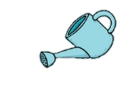




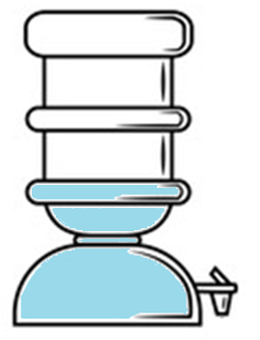





Engagement
Personal Reserve
Flourishing
Personal Reserve
Inefficient EMR
Too much secretarial work
Tons of time in documentation that is not high yield
Healthcare inequities
Personal responsibilities outside of work
Knowing EMR doesn’t matter to providing good patient care
21
Notes:
Video transcript for this slide (Suzie Reed):
When we think of the idea of flourishing or of thriving in our personal and professional life, we can think of it as having a personal reserve, having a full tank or a full water cooler, as this image shows. And each of those stressors that we talked about and maybe specific stressors to you, the EMR, the secretarial work, depletes that personal reserve, feeling like the EMR is a barrier to providing good patient care, again, continuing to deplete, more stressors, depleting, and depleting that personal reserve that we have that allows us to practice in the way that we want to practice. We like to think of and we hope to convince you that engagement in our job, engagement with our peers, in the systems to improve them to meet our needs helps refill this, our bucket, refill our bucket, refill our cooler. It helps really bring us to a place of flourishing in our professional environment. So what now? We have identified that engagement is powerful for physicians and powerful for job satisfaction, but we've also identified
that engagement feels can feel like just one more thing when we have so many stressors in our working environment. You likely have many of these stressors of your own and common to others and some unique. So next, we're going to explore ways to address these.
We know that all these stressors drain our coping reserve. (list out stressors as water tank drains). But we would like you to remember that engaging at work actually helps fill the tank back up
We know that all these stressors drain our coping reserve. (list out stressors as water tank drains). But we would like you to remember that engaging at work actually helps fill the tank back up
Facilitator – fill in with items from list of stressors from groups

Slide 23

What now?
We know there are stressors…….you have identified plenty of them
Let’s explore ways address them
Notes:
Video transcript for this slide (Suzie Reed):
So what now?
We have identified that engagement is powerful for job satisfaction, but that it can feel like we have one more thing when we have so many stressors in our work environment. Next were gonna explore ways to address these.

Slide 24
2. Engagement
Success Story
Notes:
Now we are going to hear about an example of Engagement success

Slide 25

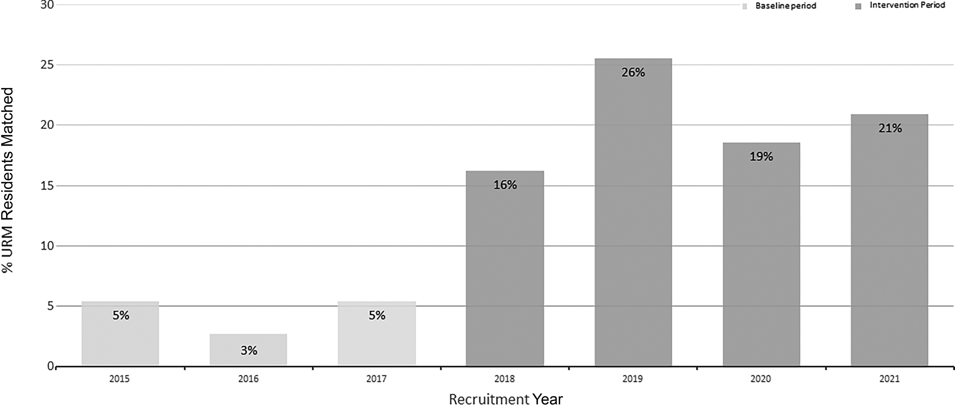
Hoff ML, et. al., Pediatrics 2021
An Initiative to Increase Residency Program Diversity
Percentage of URM residents matched per recruitment cycle.
Multifaceted approach, iterative changes = progress towards more representative program
Notes:
Video Transcription for this slide (John Mahan):
So next, I'm going to present to you an example of engagement and also give you an example of what we're going to get to do in the small group activity that's coming up in this presentation. So this is a data slide from Monica Hoff's paper recently in Pediatrics, and not that every bit of engagement lends itself to a peer-reviewed article, but I wanted to highlight this as an example of an engagement activity between residents and faculty and program directors that really resulted in a nice accomplishment, but also a real gratifying opportunity to work together and do meaningful work that demonstrated engagement and also the benefits for the individuals participating in this. This was an activity to increase the percentage of URM residents matched per recruitment cycle.
And as you can see on this graph, from a baseline of 3% to 5% per year, this QI team was able to improve URM recruitment percentages to be more reflective of the patient population served through a variety of measures that were undertaken over these several years. They used a multifaceted approach. It involved iterative changes and ultimately led to to a progressive increase and a more representative program. And again, the key here is not what they accomplished as much as this was a group activity that led to a lot of job satisfaction, a sense of accomplishment, and ultimately demonstrates how engagement can be a positive for professionals.

Slide 26
GROUP ACTIVITY: Other Examples of Engagement in Action
Bronchiolitis Clinical Pathway Design Group
Inpatient Admission Optimization Task Force
QI Project to Improve Vaccination Rates in Primary Care
Departmental Mentorship Committee
Volunteer to Trial New Scheduling Program for Faculty/Residents
3 minutes
Notes:
Facilitator: What kinds of activities resonate with you?
Then click forward for examples
(3 min)
JDM –
Methods - Strategies included applicant interviews with URM faculty, interview dinners with URM residents, visibility at academic conferences for URM trainees, development of targeted marketing materials, and a visiting student program supported by networking with URM residents.
A physician workforce that reflects the patient population is associated with improved patient outcomes and promotes health equity. Notwithstanding, racial and ethnic disparities persist within US medical schools, making some individuals underrepresented in medicine (URM).
The primary outcome measure was the percentage of matched residents in the categorical pediatrics, child neurology, and medical genetics training programs who identified as URM. The percentage of URM residents increased to 16% (6 of 37) in 2018, 26% (11 of 43) in 2019, 19% (8 of 43) in 2020, and 21% (9 of 43) in 2021 (a four-year average of 22% URM residents; P = .0002).

Slide 27
Keys to Success
Engage in something you care about
Engage with colleagues who care about the issue
  Helpful to include those with differing perspectives
Enlist support/sponsorship of your boss
Start small AND meaningful
Notes:
Video Transcription for this slide (John Mahan):
So Id like to take a moment and jus t point out some keys to success that we believe can help you really do well in an engagement activity and reap the benefits of engagement for you and the folks you work with; what we like to call the microenvironment.
First of all its really valuable to engage in something you care about. Something in your work environment where your effort and energy to make it better are gonna be a good thing for you and you care about that task.
A second item is to engage with colleagues who care about the issue. Its helpful to include those with differing perspectives, you're more likely to come to a good solution when you have different perspectives. But there’s something special about the engaging with colleagues that makes it a positive for you and your colleagues that you're doing it together.
We think its also important to enlist the sponsorship and support of your boss. To pursue an area of improvement in your microenvironment in your team in your area that is imp to the boss as well is more likely to result in a successful outcome and be appreciated and be implemented.
Lastly start small and meaningful. Not talking about getting involved in large hospital wide initiatives necessarily. In fact we would argue that its better to start small and do things that are more likely to come to success in a reasonable period of time and therefore be meaningful to you

Slide 28
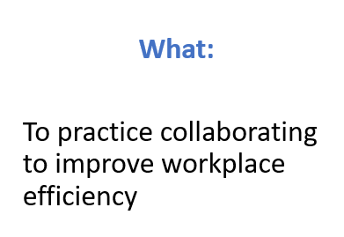
Engagement Practice
Why:
To start to understand how it feels to be involved in the process of system change
Notes:
Video Transcription for this slide (John Mahan):
So the what of engagement is to practice collaborating to improve the workplace efficiency. So that’s the activity we’re gonna have you do is work through something where you’re collaborating with others to improve efficiency in your work area
Why this is important is for you to start to understand how it feels to be involved in the process of systems change.

Slide 29
Engagement Practice
Small Groups (Work on 1 case)
  When you get into your group:
  Assign a scribe
  Review Worksheet
  Choose a spokesperson
  You have 12 minutes to review scenario and generate action plan (2 discrete plans, with associated steps)
Notes:
Video Transcription for this slide (John Mahan):
We’re gonna have you in a moment break out into small groups and work on one case.
When you get into groups: assign a scribe, review worksheet and the case/problem, choose a spokesperson
You’ll have about 12 min to review the scenario and generate an action plan with several specific steps.
Small Group Case Discussions (12 min)
Change #4?

Slide 30
Sample Case: Time Off Scheduling
Your department has doubled in size over the last year. Personnel in your department often want to attend the same conferences and take vacations at the same time. In order to maintain clinical coverage, the policies need to be adapted.
Generate action-oriented solutions for positive engagement in this issue
Notes:
Video Transcription for this slide (John Mahan):
So we’ll give you an example. Here’s a case
*He reads the above scenarios*
So your task with your group is to generate

Slide 31
Sample Case: Time Off Scheduling
Potential Actions:
Hire PRN staff to be able to accommodate all staff to PTO requests
Require PTO requests to be made each quarter
Approve requests on a rolling basis (first come, first served)
Rotate who has the opportunity to attend conferences each year
Allow staff to take time off if they are able to secure clinical coverage
Lobby for part of an admin job to organize clinical coverage changes based on PTO
Notes:
Video Transcription for this slide (John Mahan):
So for example, you might generate these type of actions. You should come up with your own, but you might generate actions like:
*reads the list*
So these would be some potential actions and then on your worksheet write in these potential solutions and identify at least two steps on how that might be implemented in your work environment.

Slide 32
3. Brainstorming
Exercise

Slide 33


Keep an Open Mind!
Notes:
Video transcript for this slide (Suzie Reed):
so as you move into this next activity, we really want to encourage you to keep an open mind. It can really feel like you're pushing a giant boulder up a hill when you're trying to engage in some sort of systems improvement when you already have an overwhelming to-do list. So we realize this can feel like, you know, one more thing, one more really difficult to achieve thing.

Slide 34
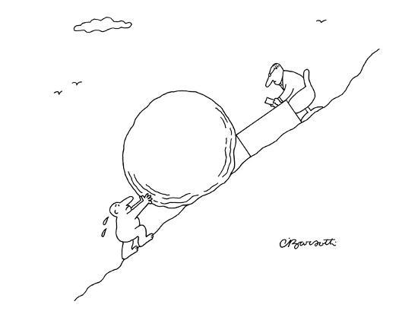
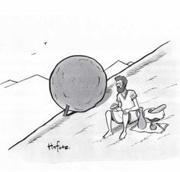
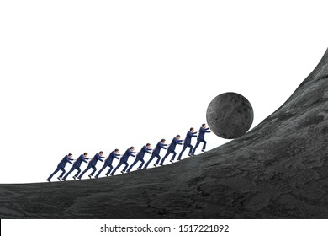
Notes:
Video transcript for this slide (Suzie Reed):
And when thinking about these difficult tasks, there are the more common things that we consider, the importance of taking breaks and taking rests, the importance of considering the barriers that you might face when undergoing a challenging intervention or systems improvement, and also making sure that we work efficiently and work together.

Slide 35
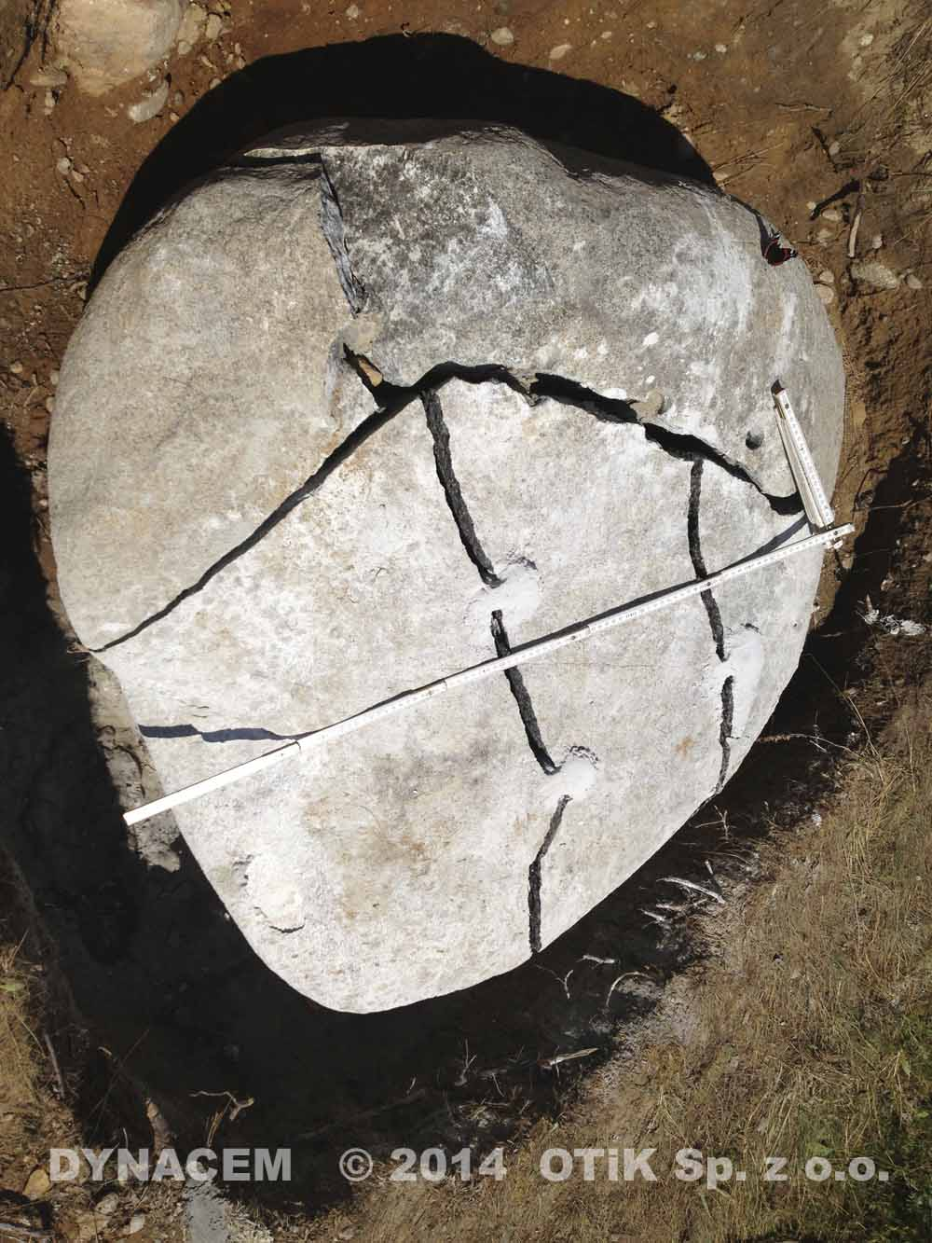
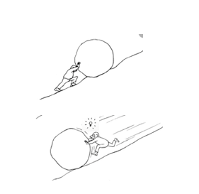
Notes:
Video transcript for this slide (Suzie Reed):
But knowing that this is a challenging task set before you, we also want to encourage you to think a little creatively and maybe think outside the box a little bit. Maybe it means changing your summit or breaking up your rock and looking at it differently. Or maybe it means pushing your rock in a different direction than you were expecting or that you had planned. So keep those ideas in mind as you move into this next activity.

Slide 36
SMALL GROUP ACTIVITY:
Engagement in Action
Small Groups of 2-4 (Work on 1 case)
  Assign a scribe
  Review Worksheet
  Choose a spokesperson
  Review scenario and generate action plan (2 discrete plans, with associated steps)
Remember: Try to keep an open mind!
12 minutes
Notes:
JDM
It can be easy for think “that will never work” or “no one at my intuition will support this”. We want to challenge you to change your thinking to “what would it look like if this were to change?”. This mindset will allow for greater creativity in thinking about options instead of focusing on the barriers.
You may have tried things (or your organization may have tried things) in the past that haven’t worked, but try to stay open to re-thinking old ideas and generating some potential new ones

Slide 37
Let’s hear from YOU:
What solutions did you generate and how did it feel to work on these?
Notes:
FACILITATOR SLIDE (10 min)
Discussion: (not the content, but the experience)
--Could you come up with useful solutions?
--What was the most difficult in this process?
--Did you feel like there is a chance for your solution to be heard/implemented?

Slide 38
4 . Context and
Engagement

Slide 39
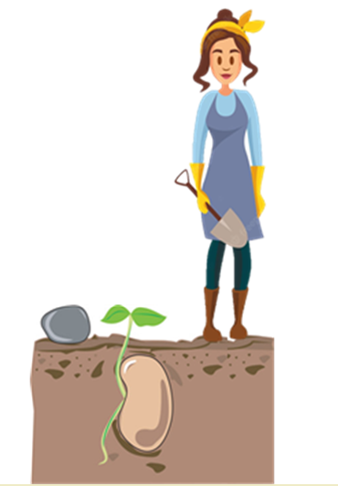
Notes:
Transcript (Suzie):
It's important to keep in mind when considering a change that you'd like to see happen or you'd like to lead that context is very important. So different contextual factors about different working environments really affect how well or how likely a change is to be successful. Some seeds will grow in any environment while others require very specific very specific environmental factors to thrive. And so it's important to consider that when working through your change that you would like to see through.
The variability in results of changes in different places and organizations is because certain context influences make it easier or more difficult to implement the intervention fully, and these influences are present or absent to a greater or lesser degree in different places or in different organizations.
These context influences are more and less important at different stages in selling, starting, progressing, sustaining and spreading an improvement. Some seeds will grow anywhere in about any conditions, some require a specific environment and a gardener with specific skills.

Slide 40
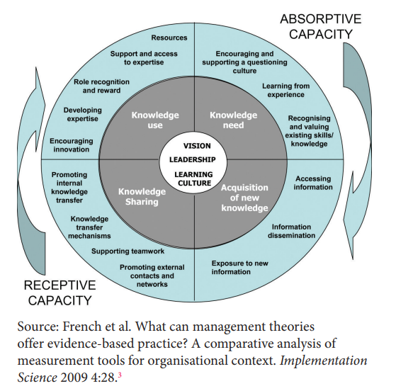
Notes:
Transcript (Suzie):
Here is a framework that can be helpful when you're considering starting out your own change. So vision, leadership, and learning culture are at the center. So important for any change, for any engagement in creating a better working environment for yourself and your colleagues.
And we also know that while vision and leadership and learning culture are essential and the core to any sort of change intervention, that using multiple strategies really increases the likelihood that the change will be successful.
Here is a concept that might be helpful to think through as you are embarking on an improvement idea. Vision, leadership, and culture are at the center. We know that implementation of improvement ideas works best when it is applied through multiple strategies at multiple levels.

Slide 41
5. Individual Planning

Slide 42
Exploring your own engagement ideas
PERSONAL REFLECTION: Use the provided worksheet to identify
  An area for collaborating to improve your work
  A few colleagues who could join you in this work
  A potential sponsor for this project
  Pair Share
Notes:
Transcription (Suzie):
So now were going to transition into a different activity where you can explore your own engagement ideas and try to personalize some of the skills you’ve been working on in this session
So the first part we’ll be taking a few minutes to have a personal reflection and we’d ask that you use the provided worksheet to work through thinking about identifying an area for collaboration to improve your own work. When we say your own work we mean your working environment, the systems your working in, not necessarily your own personal efficiency. Thinking about colleagues to work on this with you who might be interested and who might be a sponsor to help push it through.
After a few minutes of thinking about what mean the most to you then youll get time to share with a partner to get some feedback.

Slide 43
PARTNER ACTIVITY: Personal Engagement
Personal reflection for 5 minutes
  An area for collaborating to improve your work
  A few colleagues who could join you in this work
  A potential sponsor for this project
  Pair Share for 5-8 minutes

Slide 44
Keys to Success
Engage in something you care about
Engage with colleagues who care about the issue
  Helpful to include those with differing perspectives
Enlist support/sponsorship of your boss
Start small AND meaningful
Notes:
Video Transcription for this slide (John Mahan):
Okay, so welcome back. Now that you've had a chance to reflect a little bit on what issues would mean the most to you and hopefully identify one or two that you would be interested in working on, we would hope that this would be a spur for you to get engaged in something over the next three to six months that could really improve your workplace, your system, and also provides you the benefits of engaging with peers in improving systems. So remember, we've identified these four keys to success in engaging with peers in systems work. Engage with something you care about. Engage with colleagues who care about the issue, and ideally, colleagues with differing perspectives. Remember, the support and or sponsorship of your boss is important to accomplish meaningful improvements.
Talk to your boss about what you're doing and make sure that it aligns with the interest of your group and ultimately is something that your supervisor or boss will be willing to support. And remember to start small, but do things that are meaningful to you. You don't need to take on the biggest challenge, your biggest problem. You certainly are not going to be taking it on by yourself. You're going to be taking it on with peers that care about these issues like you.

Slide 45


Summary
Physician burnout, resilience and wellness: personal and social constructs
Physician ‘un-wellness’ negatively impacts patient care and physician engagement/retention
Physician engagement with peers in improving systems can positively impact on physician thriving
Notes:
Video Transcription for this slide (John Mahan):
So in summary for this session, I'd like to remind you that physician burnout, resilience, wellness, these are personal and social constructs. And they really need to be seen through this lens of connecting with others, influencing others, but also what you bring in terms of your work and your engagement. Physician unwellness can negatively impact patient care and physician engagement and retention. So we are really striving for you as physicians to be thriving and doing well. And then lastly, physician engagement with peers and improving systems can positively impact on physician thriving. We hope we've made that case with you today. And there are a list of good references on looking at involving oneself in improving systems. and the benefits not only for ourselves, but for the patients and families that we care for. Thank you.

Slide 46
References
Douglas M, Coaman E, Eden AR, et al. (2021). Lower Likelihood of Burnout Among Family Physicians From Underrepresented Racial-Ethnic Groups. Ann Fam Med. 19:342-350.
Grimes PE. Physician burnout or joy: Rediscovering the rewards of a life in medicine. International Journal of Women's Dermatology. 6(1):34-36.
Kemper KJ., Schwartz A, Wilson PM, Mahan JD,et al. (2020). Burnout in Pediatric Residents: Three Years of National Survey Data. Pediatrics. 145(1):e20191030.
McKnight-Eily LR, Okoro CA, Strine TW et al. (2021). Racial and ethnic disparities in the prevalence of stresss and worry, mental health conditions, and increase substance abuse among adults during COVID-19 pandemic - United States, April and May 2020. MMWR Morb Mortal Wkly Rwp. 70:162-166.
Mortali M, Moutier C. (2018). Facilitating Help-Seeking Behavior Among Medical Trainees and Physicians Using the Interactive Screening Program. J Med Regulation. 104(2):27-36
NICHM. (2021). https://nihcm.org/news/physician-burnout-strategies-to-promote-resilience-among-physicians
Norcross WA, Moutier C, Tiamson-Kassab M, et al. (2018). Update on the UC San Diego Healer Education Assessment and Referral (HEAR) Program. J Med Regulation. 104:17-26.
Shanafelt TD, Balch MN, Dyrbye L, et al. (2011). Special Report: Suicidal Ideation Among American Surgeons. Arch Surg. 146(1):54-62.
Shanafelt TD, Noseworthy JH (2016). Executive leadership and physician well-being. Mayo Clinic Proceedings. 92(1):129-146.
Stewart, MT, Serwint JR (2019). Burning without burning out: A call to protect the calling of medicine. Curr Probl Pediatr Adolesc Health Care. 49:100655.
West CP, Dyrbye LN, Shanafelt TD. (2018). Physician burnout: Contributors, consequences and solutions. J Intern Med. 283:516-529.
Wilson P, Batra M, Kemper KJ, Staples BB, Mahan JD, Serwint JR. (2019). Physician Well-being. Pediatrics in Review. 40(Supplement 1):12-20.
Notes:
SMR

Slide 47
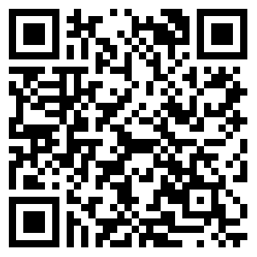
Thank you!
We want your feedback!
Help us by completing this short 3 question session evaluation
We will also send a very short survey in 2 weeks
Additional resources are on the handout if you need more support
Notes:
SMR

